Slide 1
Getting started with Discovery and Open OnDemand
Instructor:
Shobana Sekar, Ph.D.
Associate Bioinformatician
Research Computing, ITS

Slide 2
Discovery Overview
Connecting to Discovery
Software on Discovery
Storage on Discovery
Discovery through Open OnDemand
Interactive Session Exercises
(Please follow along hands-on as we demo the exercises)

Slide 3
Accessing the training material
Download the Discovery-Basics-Oct2021.zip to your local machine.
Copy the training material to your $HOME directory on Discovery. You can use one of these options:
Using the File Explorer on OOD: https://ood.discovery.neu.edu/ Instructions: https://rc-docs.northeastern.edu/en/latest/using-ood/fileexplore.html
Using ’scp’ through the terminal/shell: https://rc-docs.northeastern.edu/en/latest/using-discovery/transferringdata.html?highlight=scp#
Access a Discovery Linux shell/terminal and unzip the material
(Mac: Use Terminal; Windows: Use MobaXterm)
ssh <username>@login.discovery.neu.edu
$ unzip ~/Discovery-Basics-Oct2021.zip

Slide 4
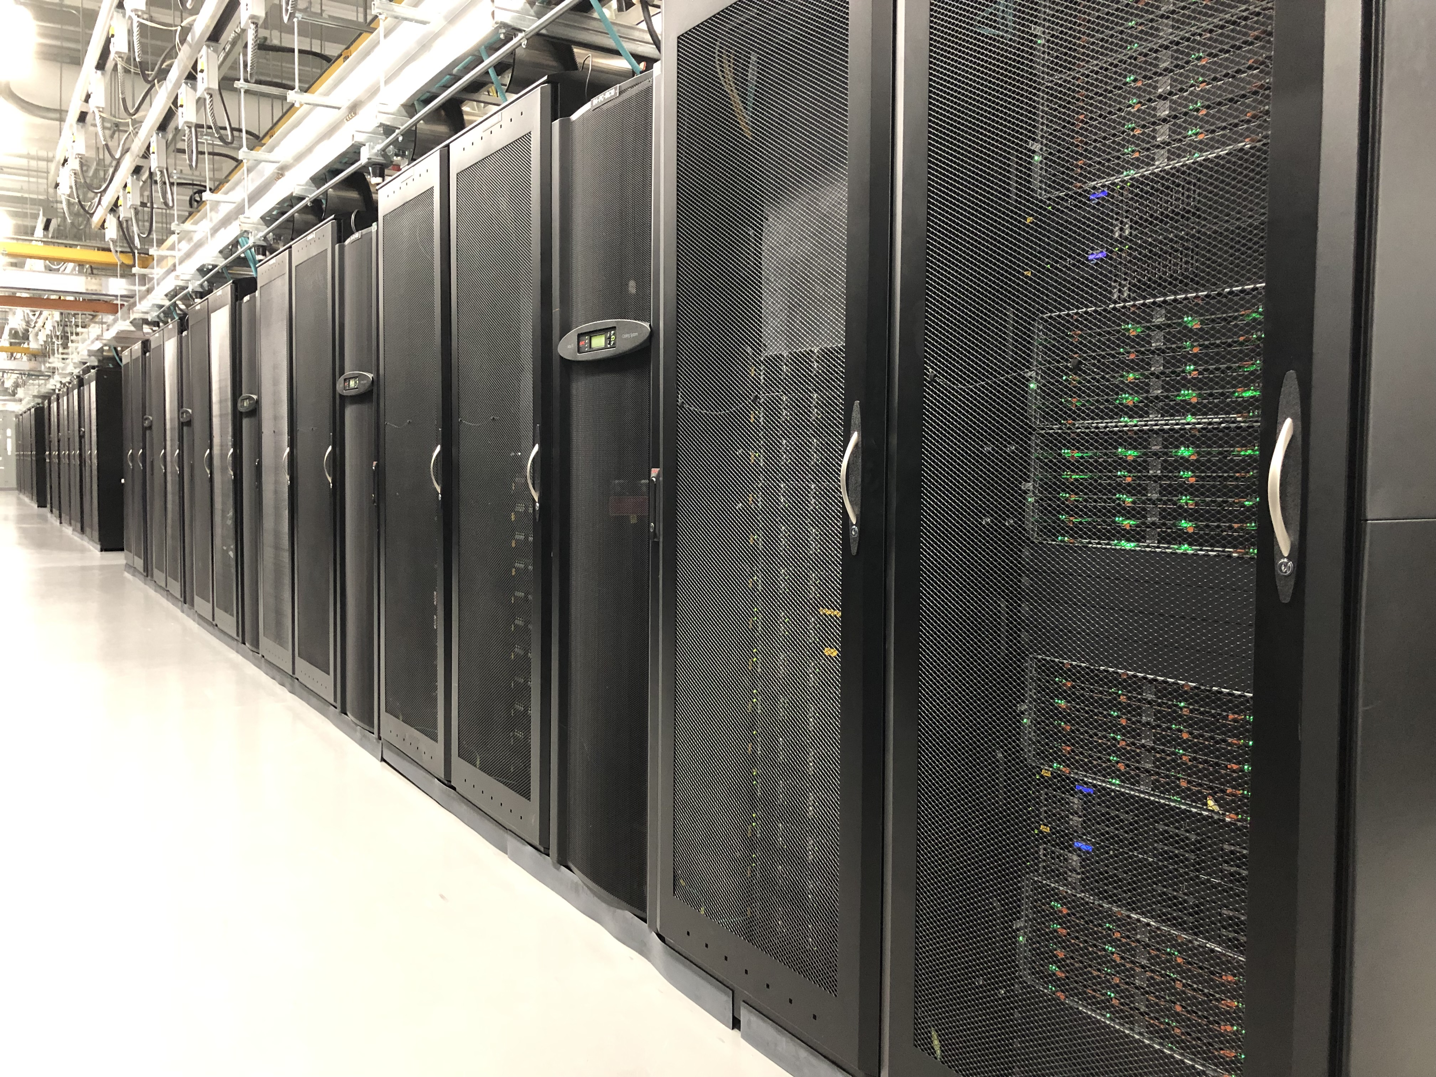
Discovery cluster
Northeastern’s high performance computing cluster, located in MGHPCC (Holyoke, MA). https://www.mghpcc.org/
25k+ public CPU cores, over 200 GPUs, & 1200 nodes.
Connected to Northeastern via 10 Gbps Ethernet (GbE) for high-speed data transfer.
Active, archive, secure, and cloud storage solutions.
Notes:
https://rc-docs.northeastern.edu/en/latest/hardware/hardware_overview.html

Slide 5
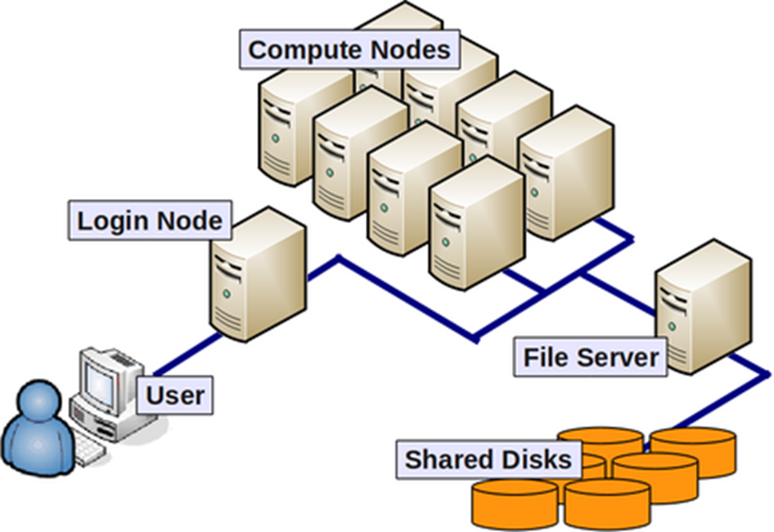
General terminology
Compute nodes: servers that perform HPC calculations.
Login nodes: servers for remote connection to the cluster - this is where you land upon logging into Discovery.
Network: connection between nodes (LAN).
Scheduler: manages HPC resources/job scheduling between users. Discovery uses the Slurm scheduler.
Partition - (on the Discovery cluster) are groups of nodes that are grouped into logical sets.
Image from: https://wiki.rc.hms.harvard.edu/display/O2/O2+HPC+Cluster+and+Computing+Nodes+Hardware
Notes:
Compute node / Node - a standalone computer/server/worker node in the cluster, which is running its own instance of the operating system (typically, Linux-OS like CentOS) and is interconnected with the other nodes via a network. Usually has multiple CPUs/processors/cores a separate memory, network interfaces, etc.
CPU / Socket / Processor / Core - may vary upon context and manufacturer. Initially, a CPU (Central Processing Unit) was referred to a single component within a computer. When multiple CPUs were introduced, each CPU was subdivided into multiple "cores", which were considered single processing units. Sockets are referred to as CPUs with multiple cores, though this term can depend on the vendor.
Task - A logical section of a computational workflow, typically a program or a set of instructions that is executed by a parallel unit. A parallel program consists of multiple tasks executed simultaneously.
Network - different nodes in the cluster are usually connected to each other through fast local area networks (LAN). Faster connections like InfiniBand (IB) connection provide high throughput and low latency.
Partition - (on the Discovery cluster) are groups of nodes that are grouped into logical sets.
Clock cycle - the speed unit of a CPU and corresponds to the electronic pulse of a CPU, during which the CPU performs a basic operation.

Slide 6
CPU Partitions on Discovery
Partition Name | Requires approval? | Time limit (default/max) | RAM limit | Use Case
debug | No | 20 minutes/20 minutes | 256GB | Best for serial and parallel jobs that can run under 20 minutes. Good for testing code.
express | No | 30 minutes/60 minutes | 25TB | Best for serial and parallel jobs that can run under 60 minutes.
short | No | 4 hours/24 Hours | 25TB | Best for serial or small parallel jobs (--nodes=2 max) that need to run for up to 24 hours.
long | Yes | 1 day/5 Days | 25TB | Primarily for serial or parallel jobs that need to run for more than 24 hours. Need to prove that your code cannot be checkpointed to use this partition.
large | Yes | 6 hours/6 Hours | N/A | Primarily for running parallel jobs that can efficiently use more than 2 nodes. Need to demonstrate that your code is optimized for running on more than 2 nodes.
https://rc-docs.northeastern.edu/en/latest/hardware/partitions.html

Slide 7
GPU Partitions on Discovery
Partition Name | Requires approval? | Time limit (default/max) | GPU per job limit | GPU per user limit | Use Case
gpu | No | 4 hours/8 Hours | 1 | 8 | For jobs that can run on a single GPU processor.
multigpu | Yes | 4 hours/24 Hours | 12 | 12 | For jobs that require more than one GPU and take up to 24 hours to run.
If you need access to large, long, or multigpu partitions, you need to submit a ServiceNow ticket.

Slide 8
Request A Discovery Account
Need to have an NU account & a sponsor before requesting a Discovery account.
Sponsor approves your access request form.
All student club members must indicate Slurm account they would like to be associated with & communicate to RC.
Access request form and more information available on https://rc-docs.northeastern.edu/en/latest/get_started/get_access.html

Slide 9
Connecting - Demo
Mac: Use Terminal
Windows: Use MobaXterm
ssh -Y <username>@login.discovery.neu.edu – With X11 Forwarding
ssh <username>@login.discovery.neu.edu – Without X11 Forwarding
https://rc-docs.northeastern.edu/en/latest/get_started/connect.html

Slide 10
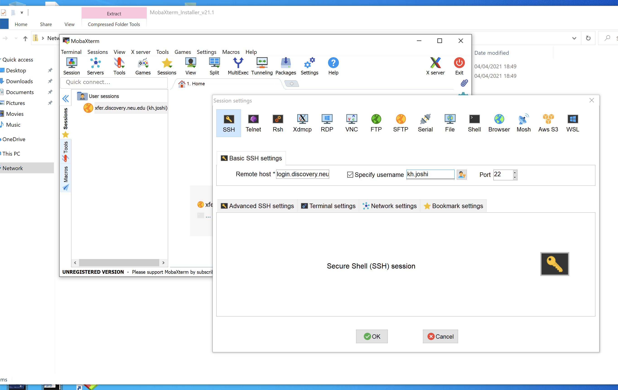
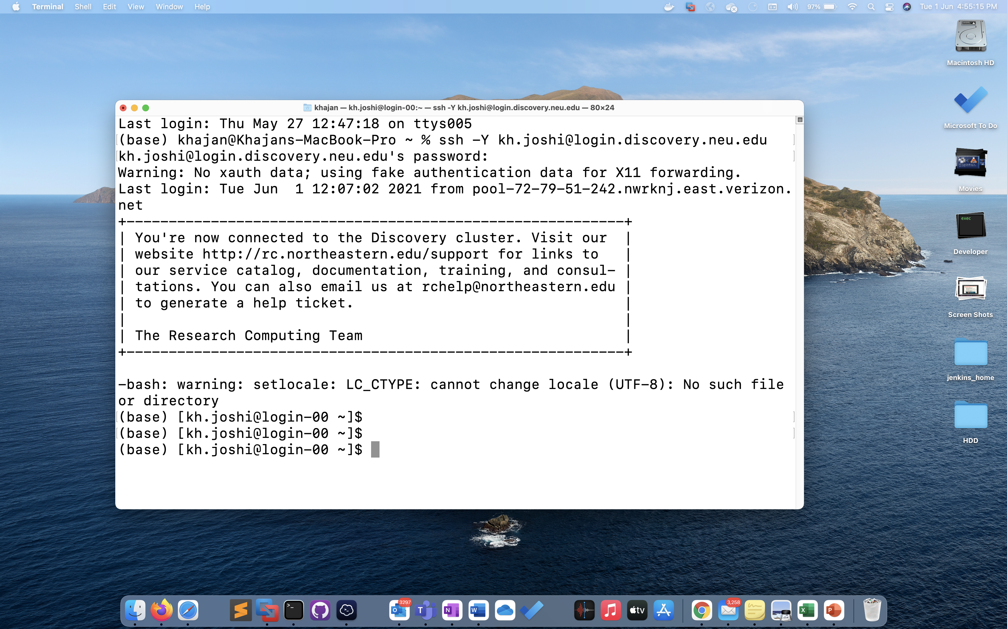
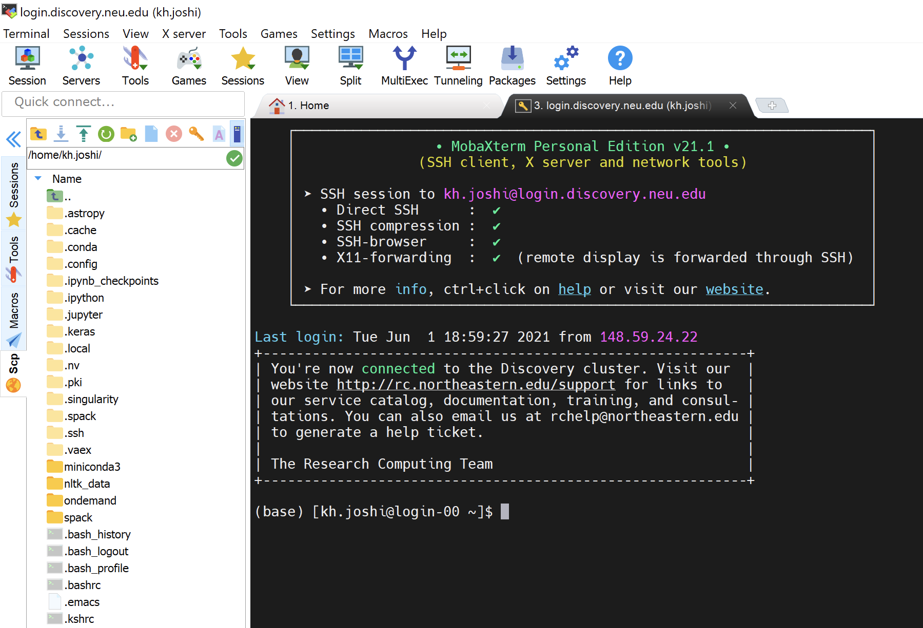
LOGIN TO DISCOVERY
$ ssh –Y username@login.discovery.neu.edu
MAC (Terminal)
Windows (MobaXterm)

Slide 11
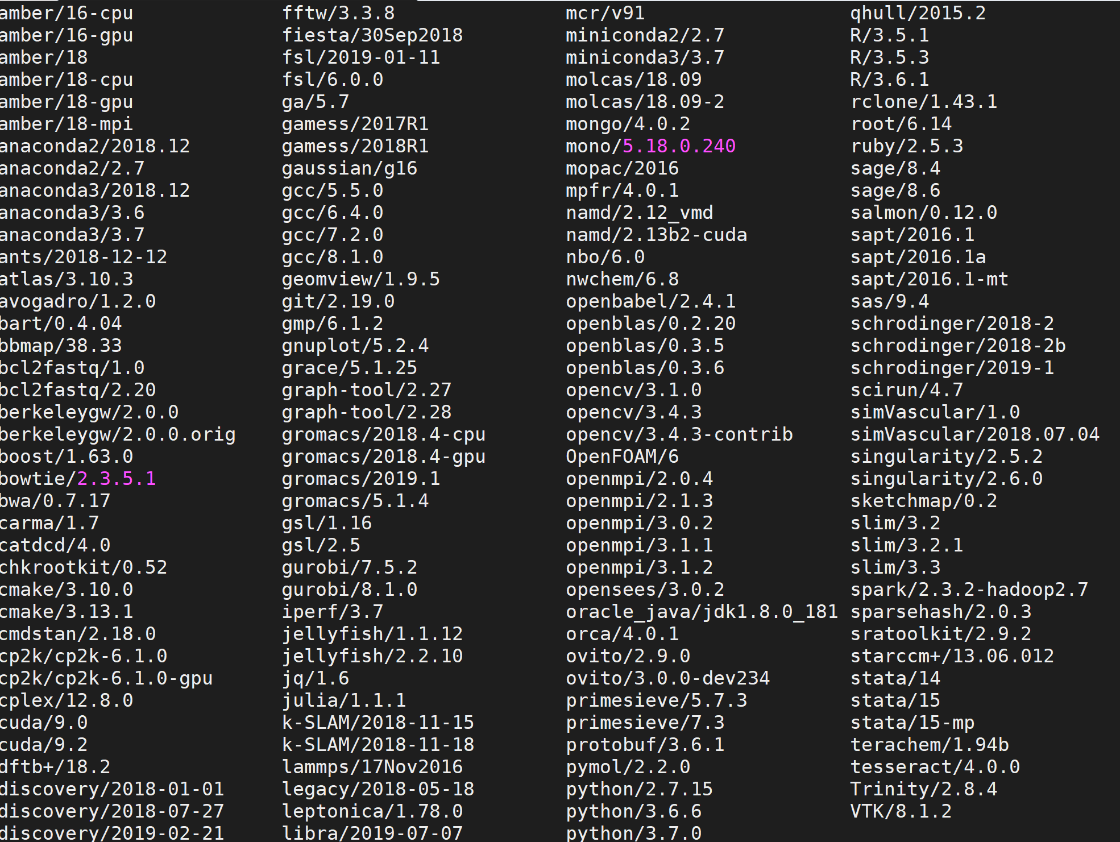
Software on Discovery
Popular software packages available as modules.
$ module avail
To load a module, do
$ module load anaconda
Install software to your local directory.
We ask users to always have clean .bashrc file.
Request software installation through ServiceNow

Slide 12
Storage On Discovery
/home
/work
Permanent & Backed up
Limited size (100GB)
Not performant
Research group specific
PI to initiate request
Permanent
/scratch
Performant
Total capacity: 1.8 PB
Temporary storage
Not backed up
28 day purge policy
/home/<user-name>
/work/<group-name>
/scratch/<user-name>
Notes:
https://rc-docs.northeastern.edu/en/latest/storage/discovery_storage.html
rc.northeastern.edu/policy

Slide 13
Transferring Data To/From Discovery
Using compute node via scp
Using xfer via sshfs
https://rc-docs.northeastern.edu/en/latest/using-discovery/transferringdata.html
Using Globus
https://rc-docs.northeastern.edu/en/latest/using-discovery/globus.html

Slide 14
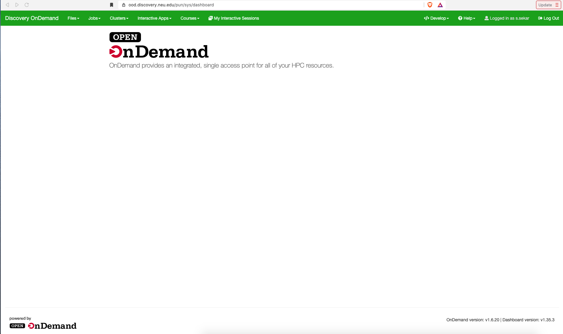
Accessing Discovery Through OOD
Open OnDemand (OOD) – web portal to Discovery cluster.
Type the URL: https://ood.discovery.neu.edu/ on your web browser (safari currently not supported) - Enter your Northeastern username/password to login

Slide 15
Accessing Discovery Through OOD
OOD allows you to launch a terminal, software applications, desktop environment etc. within your web browser.
Available software applications can be accessed through the “Interactive apps” drop down menu.
You may also view, download, copy, and delete files using the File Explorer feature.

Slide 16
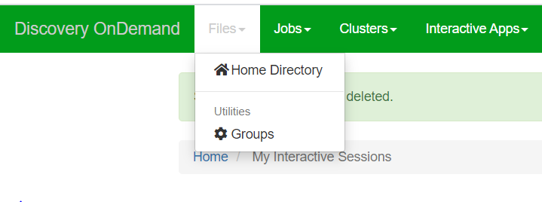
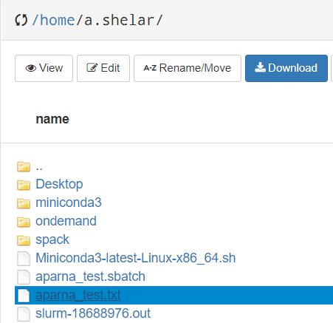
File View
To open a file, go to Files > Home Directory
Select the file you want to view and click the ‘View’ button

Slide 17


File Upload
To upload a file, click the ‘Upload’ button in the file explorer window
Select the required file/zipped folder from your computer to upload

Slide 18
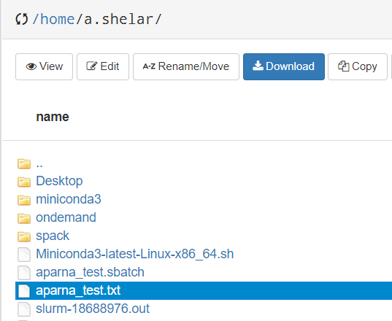
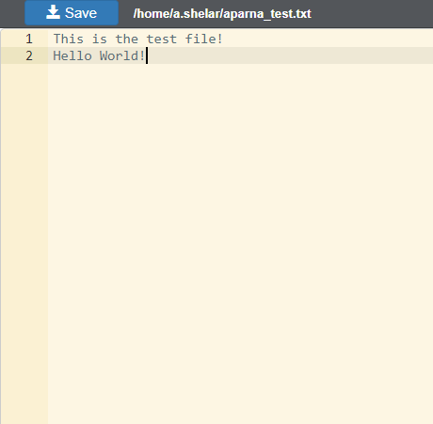
File Edit
To edit a file, select the file in the file explorer, and click the ‘Edit’ button
Edit the content as required and then click the ‘Save’ button

Slide 19
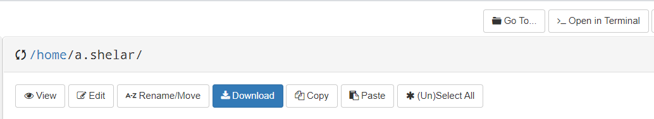
Terminal on OOD
There are 2 ways to open the terminal window on OOD :
Files -> Home Directory -> Open in Terminal

Slide 20
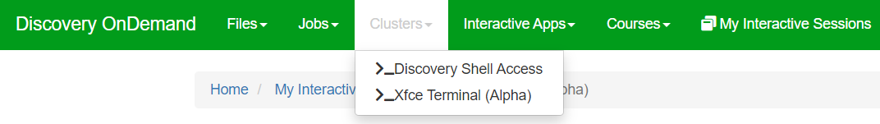
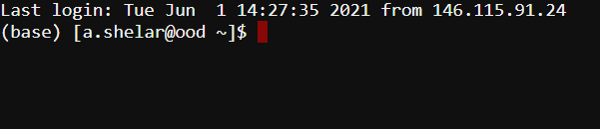
Terminal on OOD
2. Clusters -> _Discovery Shell Access

Slide 21
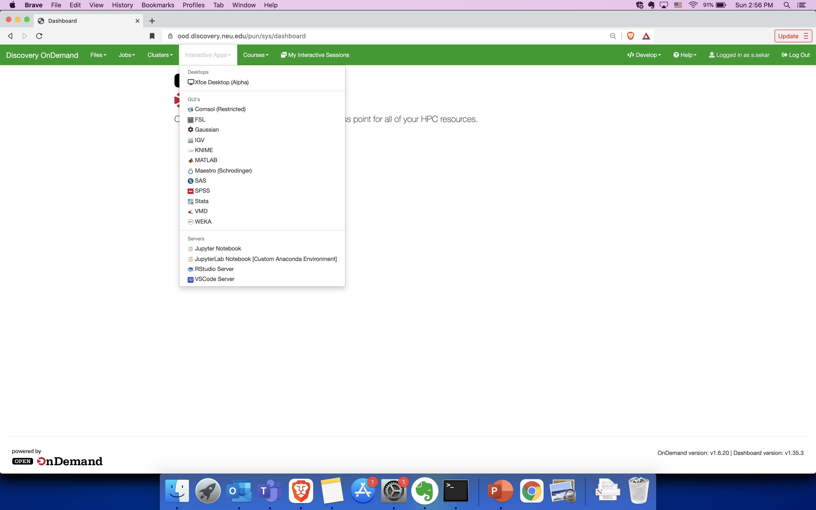
Accessing Jupyter Notebook on OOD
To launch a Jupyter Notebook on a compute node, go to Interactive Apps > Jupyter Notebook
Notes:
The Jupyter Notebook is an open-source web application that allows you to create and share documents that contain live code, equations, visualizations and narrative text. Uses include: data cleaning and transformation, numerical simulation, statistical modeling, data visualization, machine learning, and much more.

Slide 22
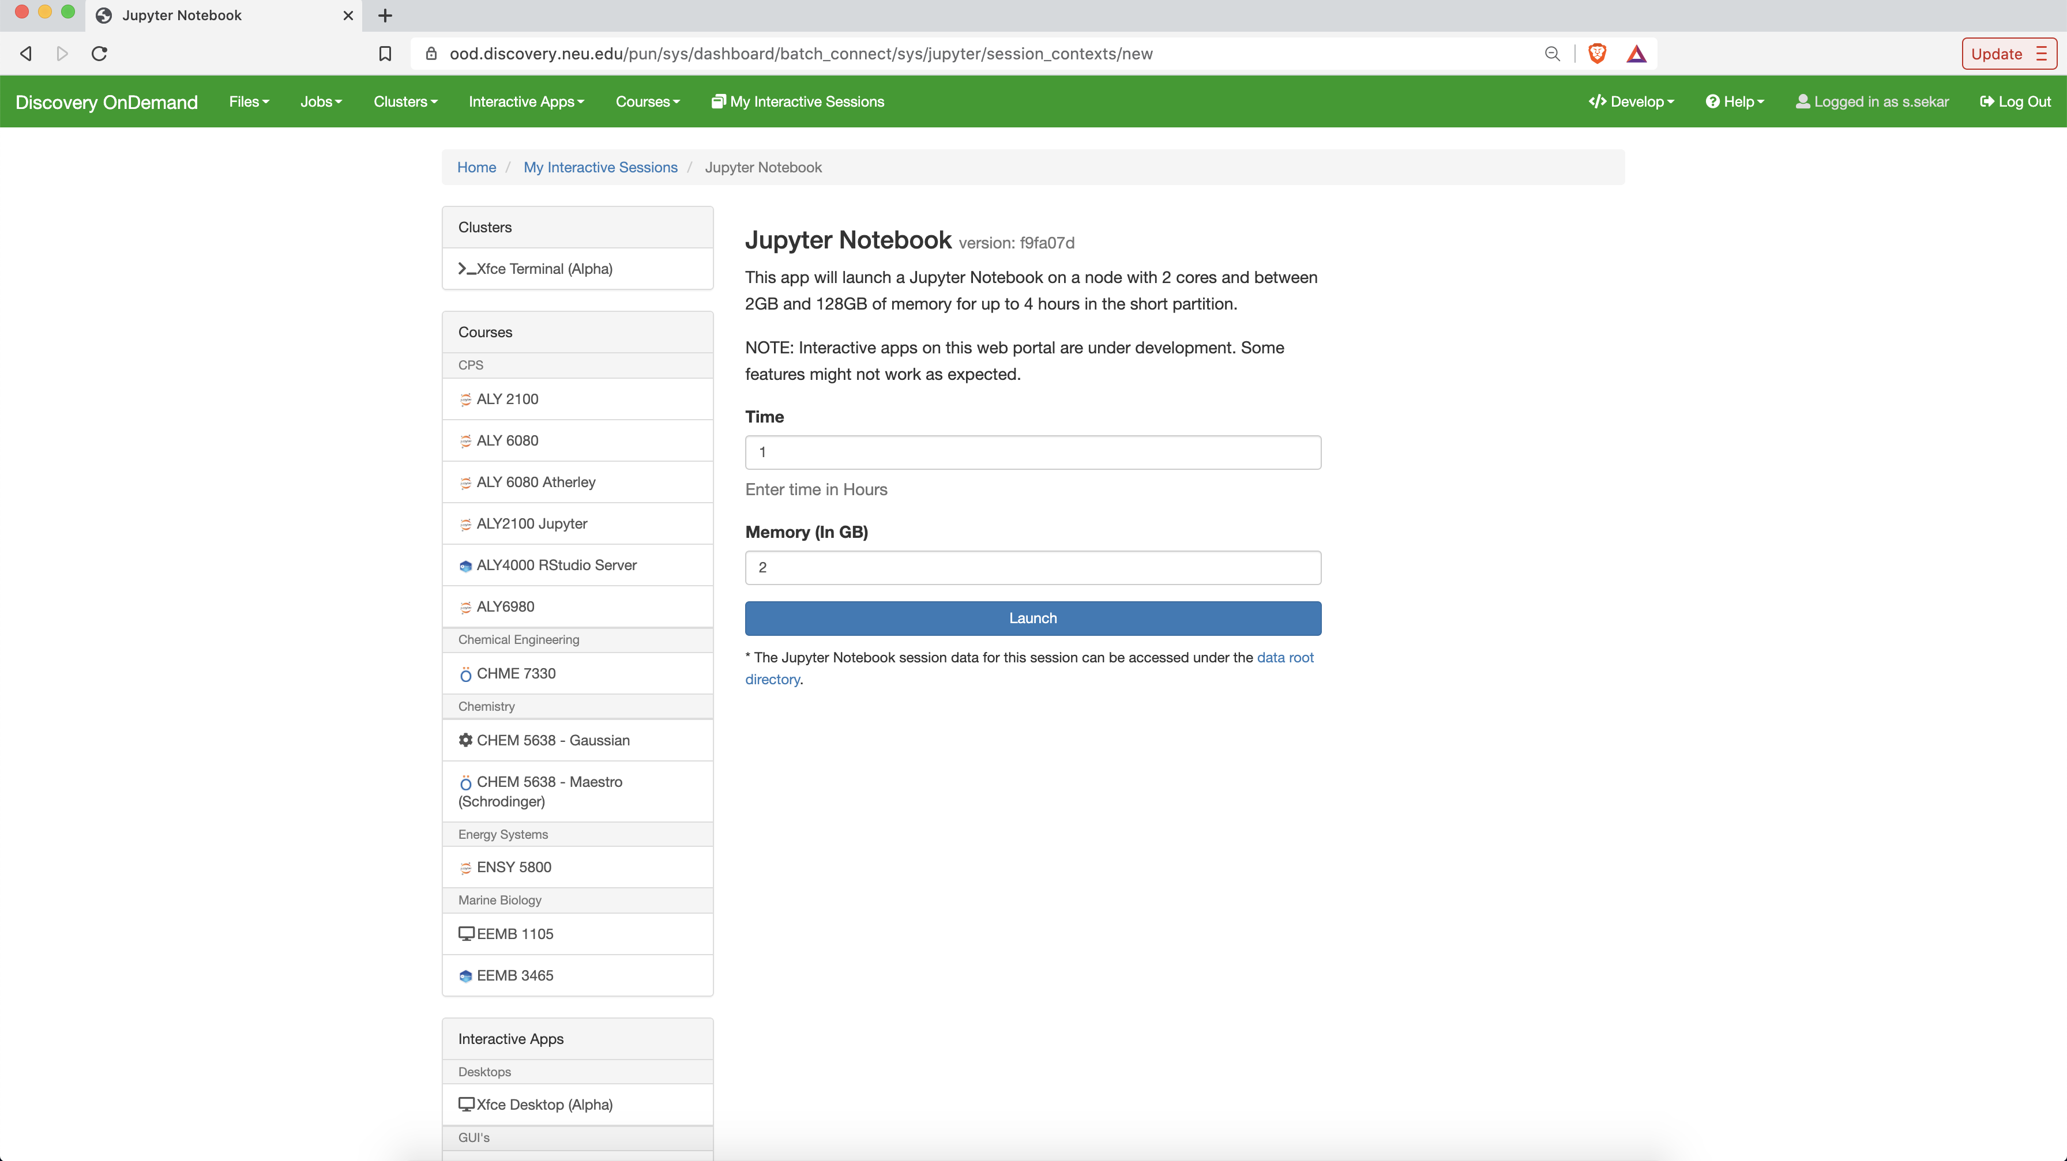
Accessing Jupyter Notebook on OOD
Select the time and memory required for your session, and click on ‘Launch’

Slide 23
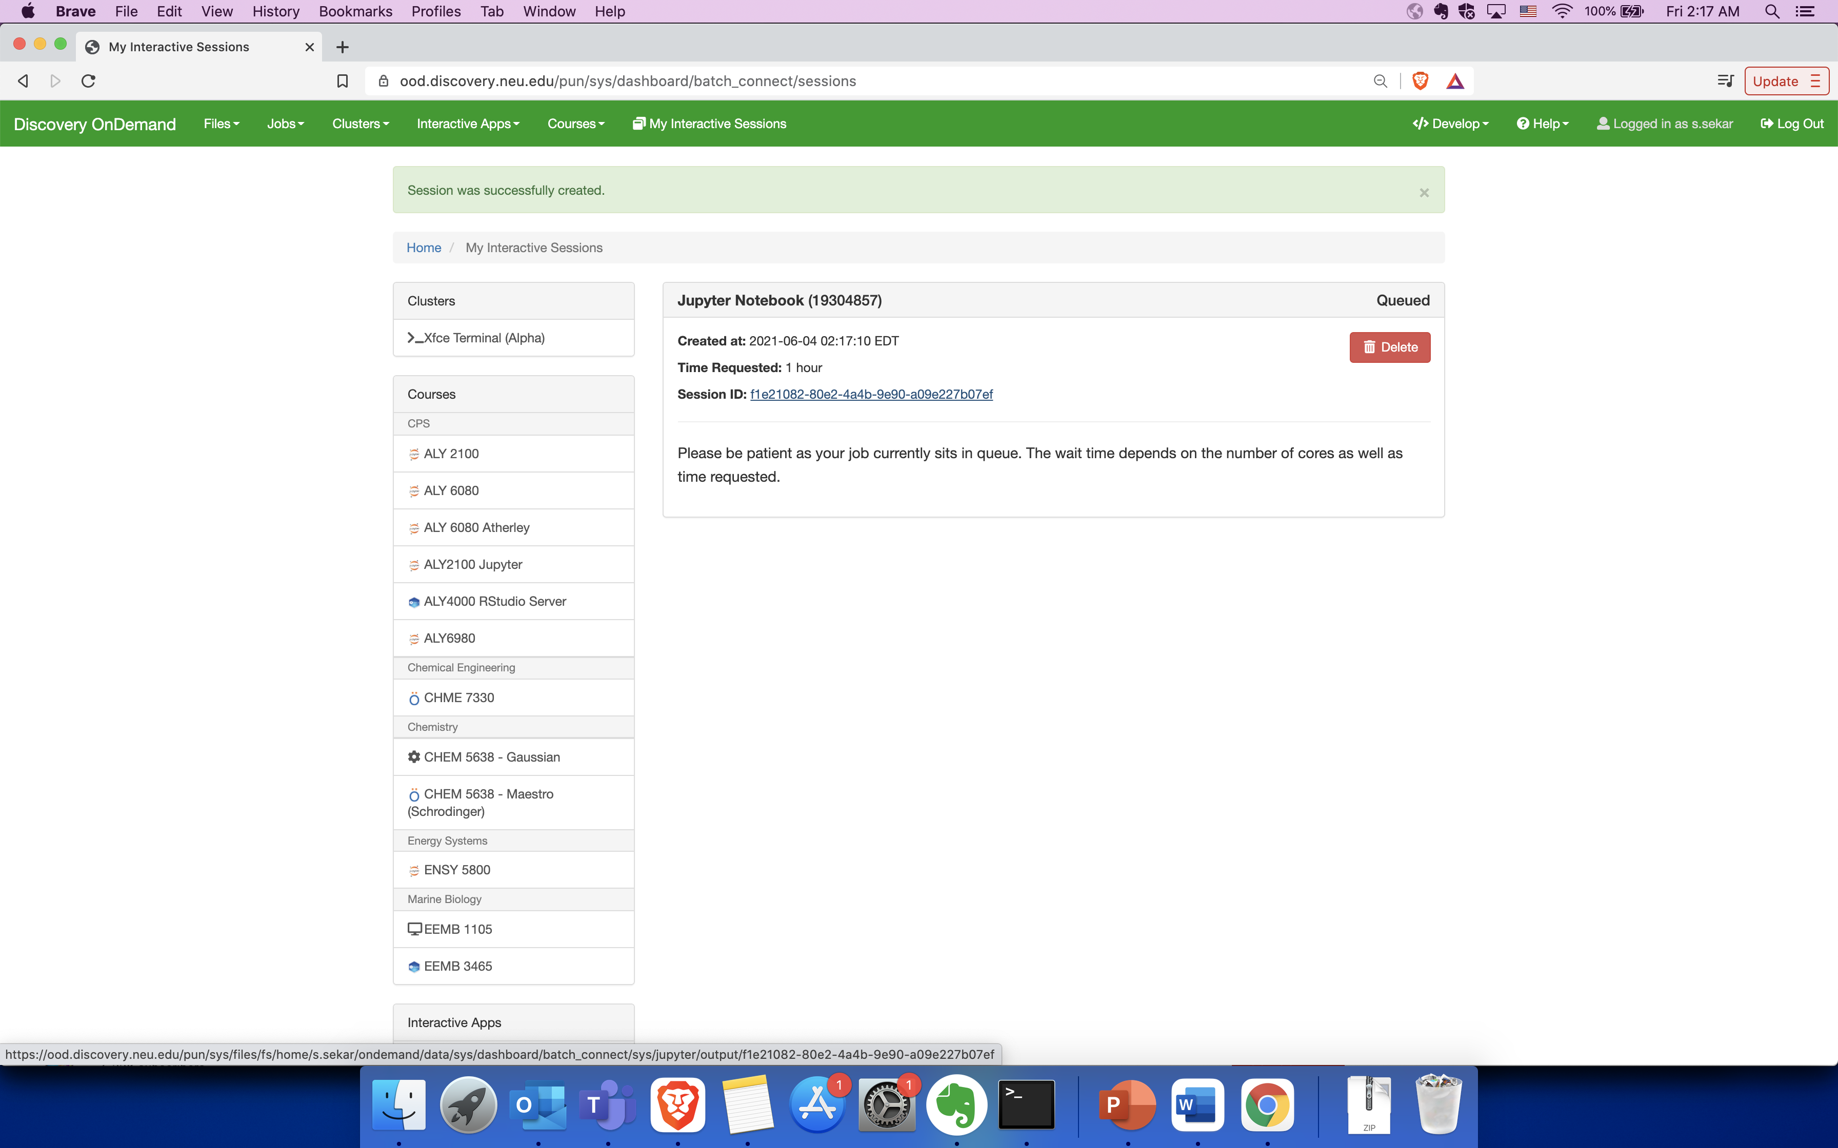
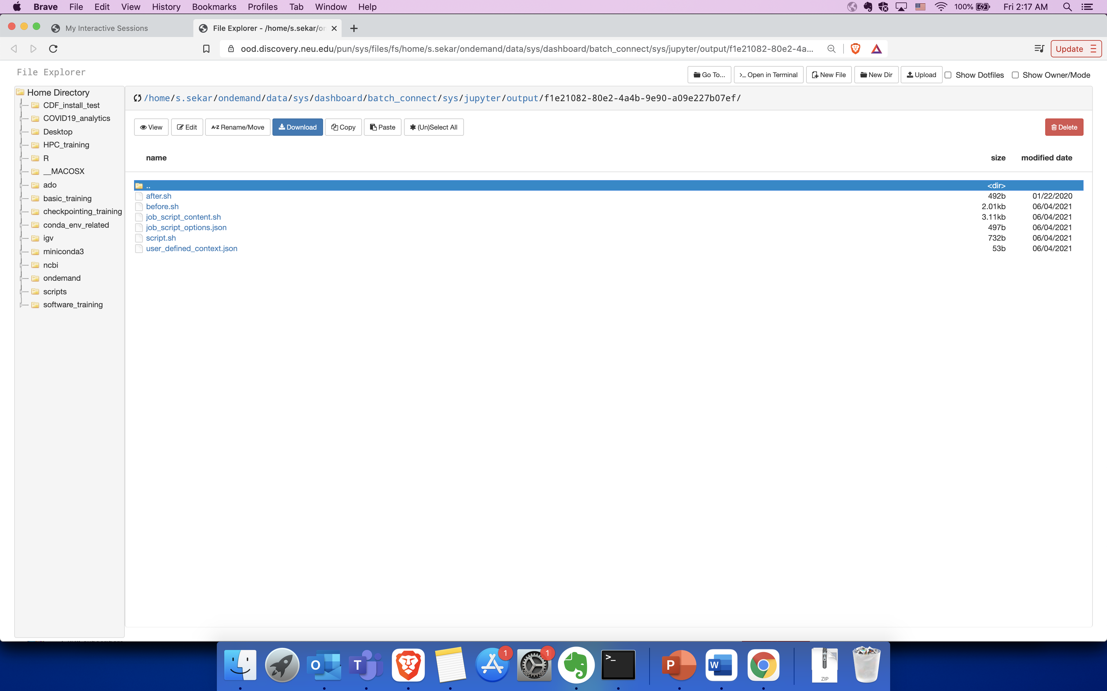
Accessing Jupyter Notebook on OOD
Click on the session ID to view session logs.
This will open a new file explorer window.
The logs and other files related to your session
will now populate here.
This is inside
/home/<username>/ondemand/data/sys/…..

Slide 24
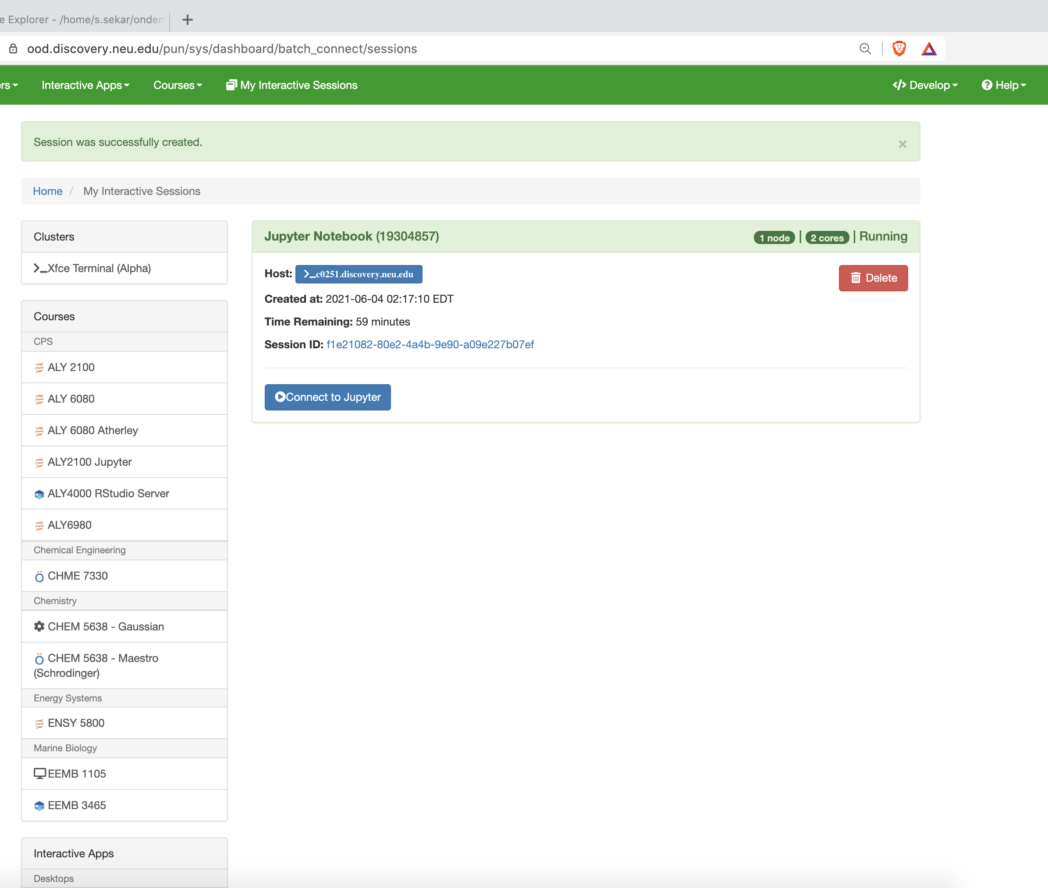
Accessing Jupyter Notebook on OOD
Once the requested resources have been allocated, you can click on ‘Connect to Jupyter’

Slide 25
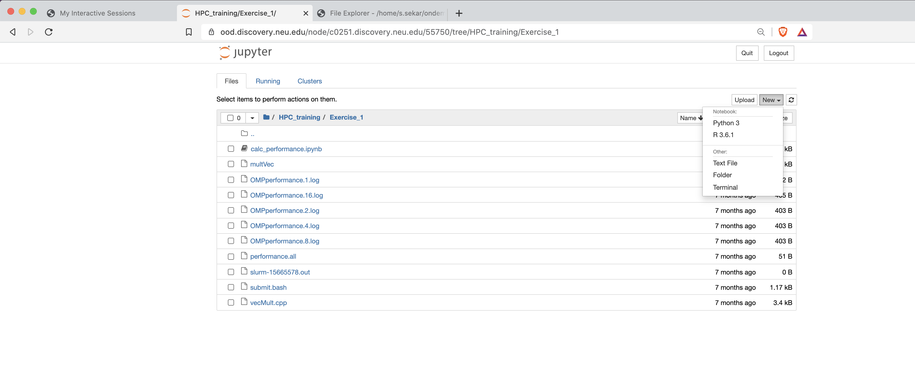
Accessing Jupyter Notebook on OOD
Open a new
notebook
Open an existing
notebook

Slide 26
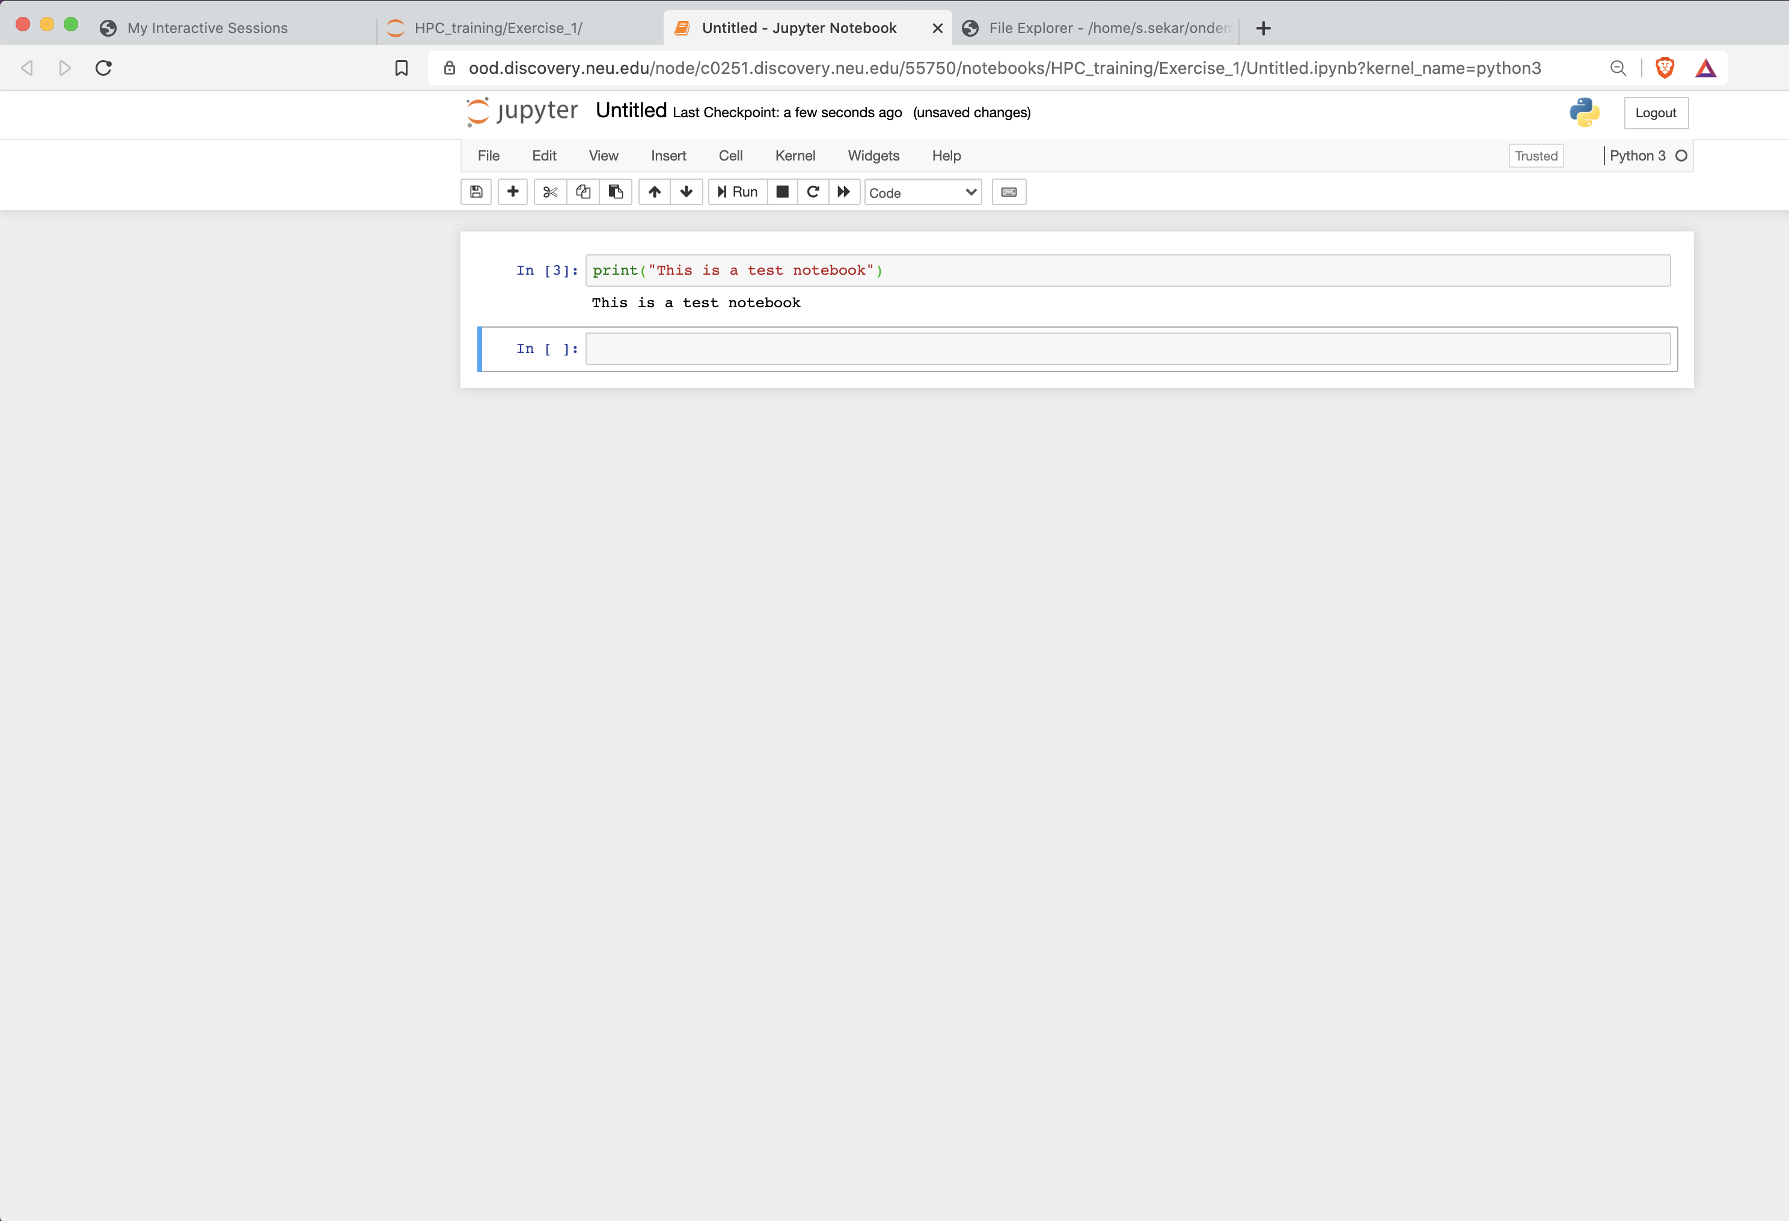
Accessing Jupyter Notebook on OOD

Slide 27
Interactive Session Exercises

Slide 28
Submitting a job on Discovery
Using srun –
Interactive way of submitting jobs
Eg: srun --pty /bin/bash
To request resources (partition, time, memory, cpu) using SRUN command, provide these options while executing it.
See https://rc-docs.northeastern.edu/en/latest/hardware/partitions.html for information on various partitions & their time limits, etc.
Using SBATCH –
Submitting jobs non-interactively
Eg: sbatch example.script
To request resources using SBATCH, the example.script file must contain resource details, such as partition, time, memory, cpu.

Slide 29
Exercise 1
Submitting an interactive job using SRUN

Slide 30
Exercise 1 SRUN (Run and monitor jobs on a compute node)
In this example, we’ll run an interactive job on the cluster, using SRUN.
SRUN (request one node, with 10 tasks and 2 CPUs per task (a total of 20 CPUs), 1GB of memory, for one hour on the express partition):
$ srun --nodes=1 --ntasks=10 --cpus-per-task=2 --mem=1G --time=01:00:00 --partition=reservation –-reservation=Oct2021cpu --pty --export=ALL /bin/bash
(For this session)
$ srun --nodes=1 --ntasks=10 --cpus-per-task=2 --mem=1G --time=01:00:00 --partition=express --pty --export=ALL /bin/bash

Slide 31
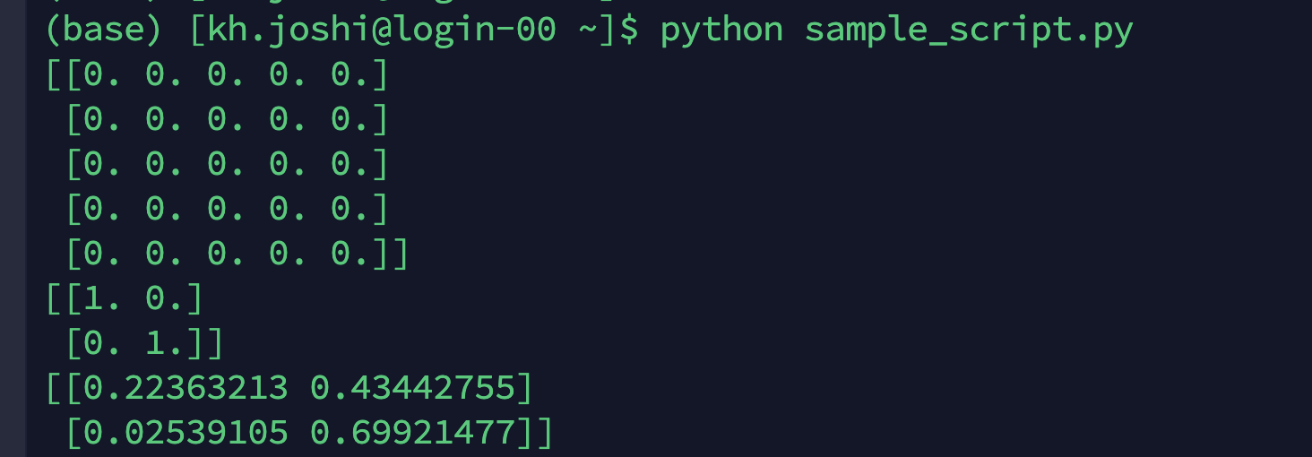
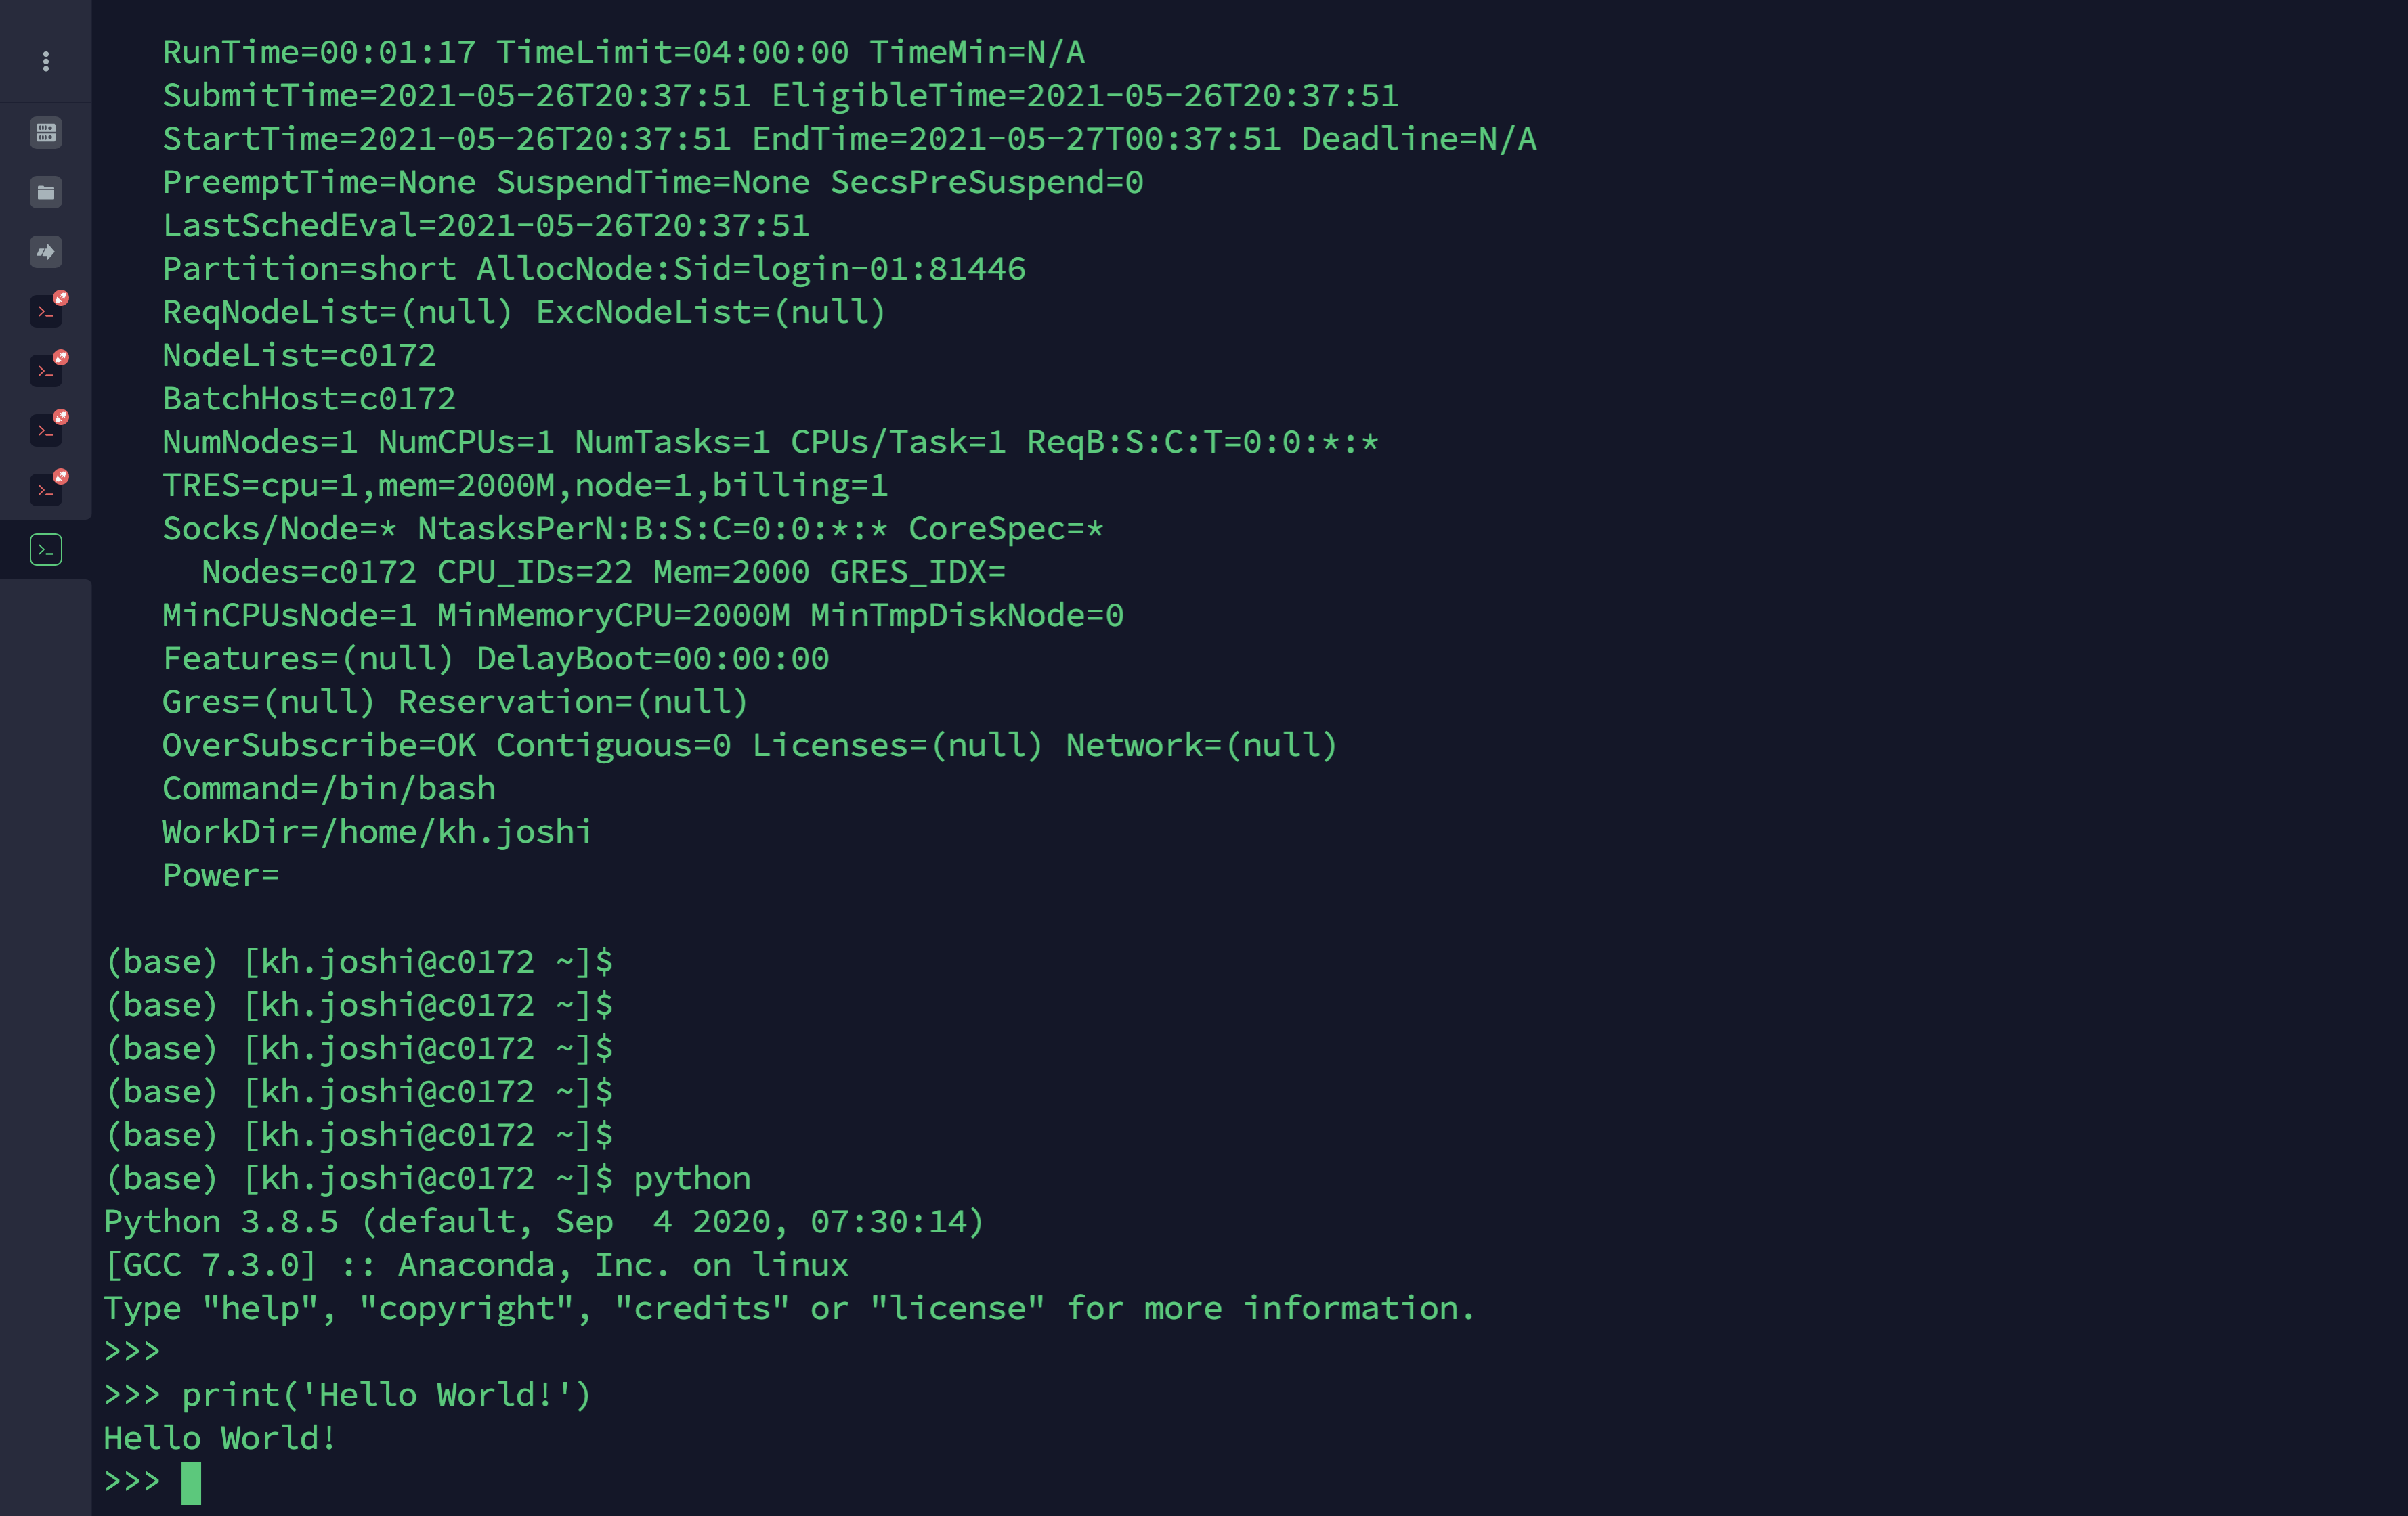
Exercise 1 Do computations on the compute node
2. Example: To start a python interactive session
$ cd $HOME/Discovery-Basics-Oct2021/Exercise1
$ module load python/3.7.1
$ python sample_script.py
3. Cancel a pending or running job on the cluster
$ scancel <job_id>
or
$ exit

Slide 32
Exercise 1 See account details
See if you are associated with multiple slurm accounts sacctmgr show associations where user=username
Choose the correct Slurm account to submit your job srun --account=accountname --partition=short --nodes=1 --ntasks=28 --pty --mem=16 GB /bin/bash
https://rc-docs.northeastern.edu/en/latest/using-discovery/usingslurm.html

Slide 33
Exercise 2
Submitting a non-interactive job using SBATCH

Slide 34
Exercise 2 SBATCH (Run jobs in the background)
Batch script has 3 main sections – Shebang, SBATCH directives & Instructions. Create an sbatch file using a text editor.
#!/bin/bash
#SBATCH --partition=reservation
#SBATCH --reservation=Oct2021cpu
#SBATCH --job-name=test
#SBATCH --time=00:05:00
#SBATCH --nodes=1
#SBATCH --cpus-per-task=1
#SBATCH --output=%j.output
#SBATCH --error=%j.error
echo "HELLO WORLD!”
Shebang – path to Bash interpreter that runs lines in file.
SBATCH directives –
Tell Slurm to allocate resources to run a job successfully.
Partition name where job needs to run.
Duration for which job is expected to run.
Number of nodes & CPUs requested.
Job name and output & error files.
%j – job ID number
Instruction – Bash command to execute when job runs

Slide 35
Exercise 2 Creating the script
1. Create the script file
$ vi sample.bash
press i to enter insert mode and then type the following script into the file. After completing typing, press ESC to exit insert mode. Then type :wq to save and exit the file
2. Contents of the script
#!/bin/bash
#SBATCH --partition=reservation
#SBATCH --reservation=Oct2021cpu
#SBATCH --job-name=test
#SBATCH --time=00:05:00
#SBATCH --nodes=1
#SBATCH --cpus-per-task=1
#SBATCH --output=%j.output
#SBATCH --error=%j.error
echo "HELLO WORLD!”
3. Run the script from a login node
$ sbatch sample.bash

Slide 36
Exercise 2 Submit job using SBATCH
You should see the following output:
When the job finishes, you should have: JOBID.output & JOBID.error
If the job completed successfully,
<jobid>.error should be empty, &
<jobid>.output should contain the output "Hello World".
$ Submitted batch job <jobid>

Slide 37
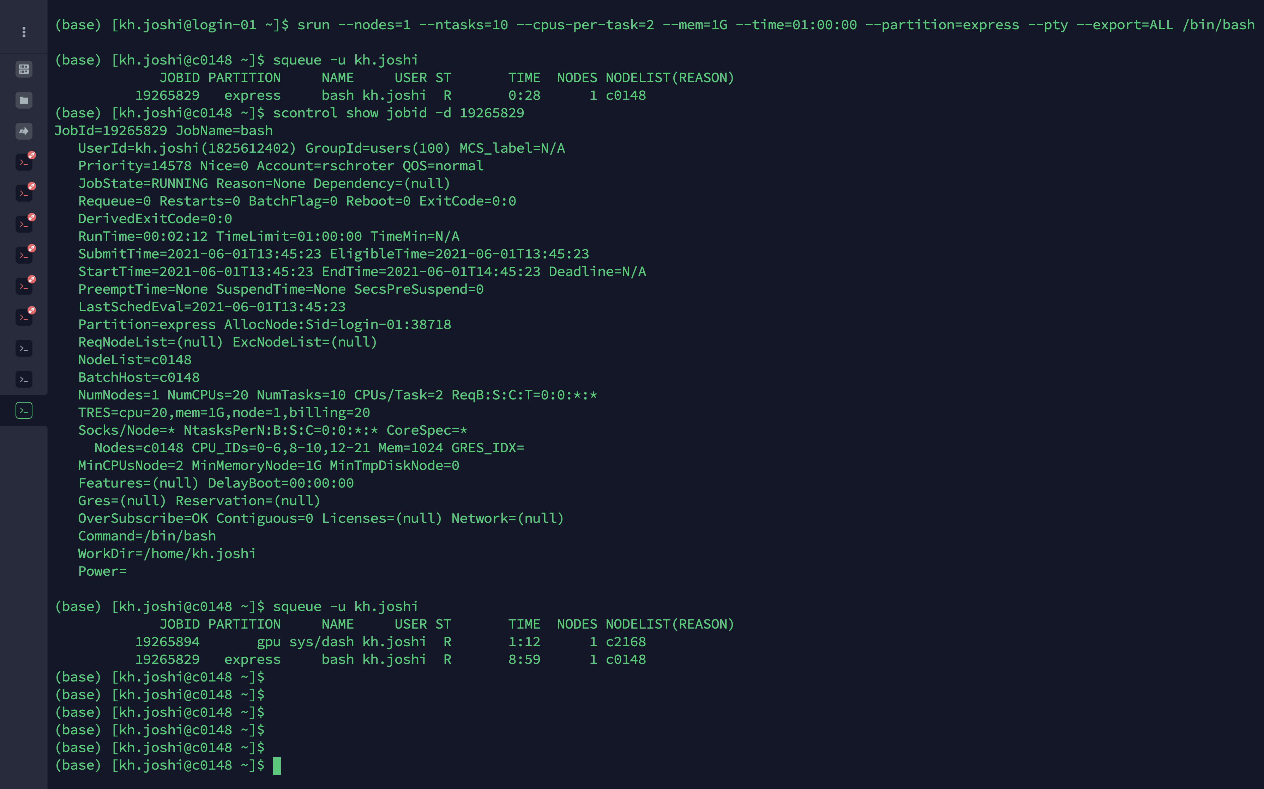
Exercise 2 Monitor your job
4.1 See your jobs with squeue
$ squeue –u <username>

Slide 38
Exercise 2 See job details
4.2. Monitoring your job with scontrol
$ scontrol show jobid -d <job_id>

Slide 39
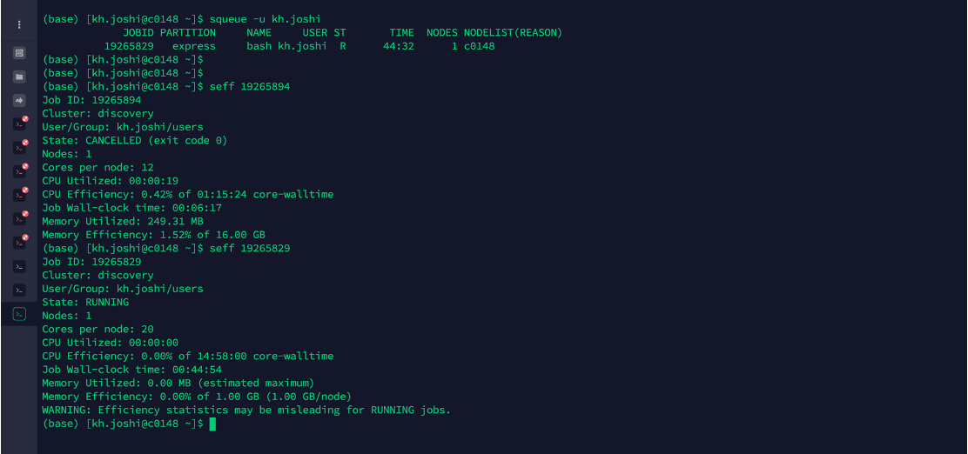
Exercise 2 See job efficiency
4.3. seff (to see the computational efficiency of your calculations)
$ seff <job_id>

Slide 40
Thank you

Slide 41
Supplemental Material

Slide 42
GPUs on Discovery
All NVIDIA GPUs on Discovery.
Range from K40 to T4.
https://rc-docs.northeastern.edu/en/latest/using-discovery/workingwithgpu.html
Access gpu partition using --gres= flag while running srun or sbatch.
Notes:
The Discovery cluster supports a variety of GPUs that offer a wide range of functionalities and capabilities.
k20m - The Tesla K20m is an enthusiast-class professional graphics card developed by NVIDIA, which was launched in January 2013. It is built on 28 nm process, is based on the GK110 graphics processor, and supports DirectX 12. For full specifications, see [7].
k40m - The Tesla K40m is an enthusiast-class professional graphics card developed by NVIDIA, which was launched in November 2013. It is built on 28 nm process, based on the GK110B graphics processor, and supports DirectX 12. For full specifications, see [8].
k80 - The Tesla K80 is a professional graphics card developed by NVIDIA, which was launched in November 2014. It is built on 28 nm process, is based on the GK210 graphics processor, and supports DirectX 12. Advertized as the world's most popular GPU on NVIDIA website, it delivers exceptional performance with fewer, more powerful servers that tremendously reduces data center costs and boosts throughput 5-10 times more in real-world applications. For full specifications and details, see [9, 10].
p100 - The Tesla P100 is an enthusiast-class professional graphics card developed by NVIDIA, which was launched in June 2016. It is Built on 16 nm process, is based on the GP100 graphics processor, and supports DirectX 12. Advertised as the world's first AI supercomputing data center GPU on NVIDIA website, it offers a unified platform for accelerating both HPC and AI, and dramatically increases throughput. For full specifications and details, see [11, 12].
v100-pcie & v100-sxm2 - The Tesla V100 series is a professional graphics card developed by NVIDIA, which was launched in March 2018. It is built on 12 nm process, is based on the GV100 graphics processor, and supports DirectX 12. Advertised as the first tensor core GPU on NVIDIA website, it is the most advanced data center GPU for AI. It comes in 16 and 32GB configurations. It offers performance of up to 32 CPUs wrapped up in a single GPU. For full specifications and details, see [13, 14, 15].
T4 - The Tesla T4 is a professional graphics card developed by NVIDIA, which was launched in September 2018. It is built on 12 nm process, is based on the TU104 graphics processor, and supports DirectX 12 Ultimate. This GPU offers breakthrough performance by accelerating various computing environments ranging from cloud to AI & graphics. It is energy-efficient and features multi-precision Turing Tensor Cores, providing up to 500 trillion tensor operations per second, and new RT Cores, for performing ray tracing operations with extraordinary efficiency. For full specifications and details, see [16, 17].
The latest Tesla 20-series GPUs are based on the latest implementation of the CUDA platform called the "Fermi architecture". Fermi has key computing features such as 500+ gigaflops of IEEE standard double-precision floating-point hardware support, L1 and L2 caches, ECC memory error protection, local user-managed data caches in the form of shared memory dispersed throughout the GPU, coalesced memory accesses, and more.

Slide 43
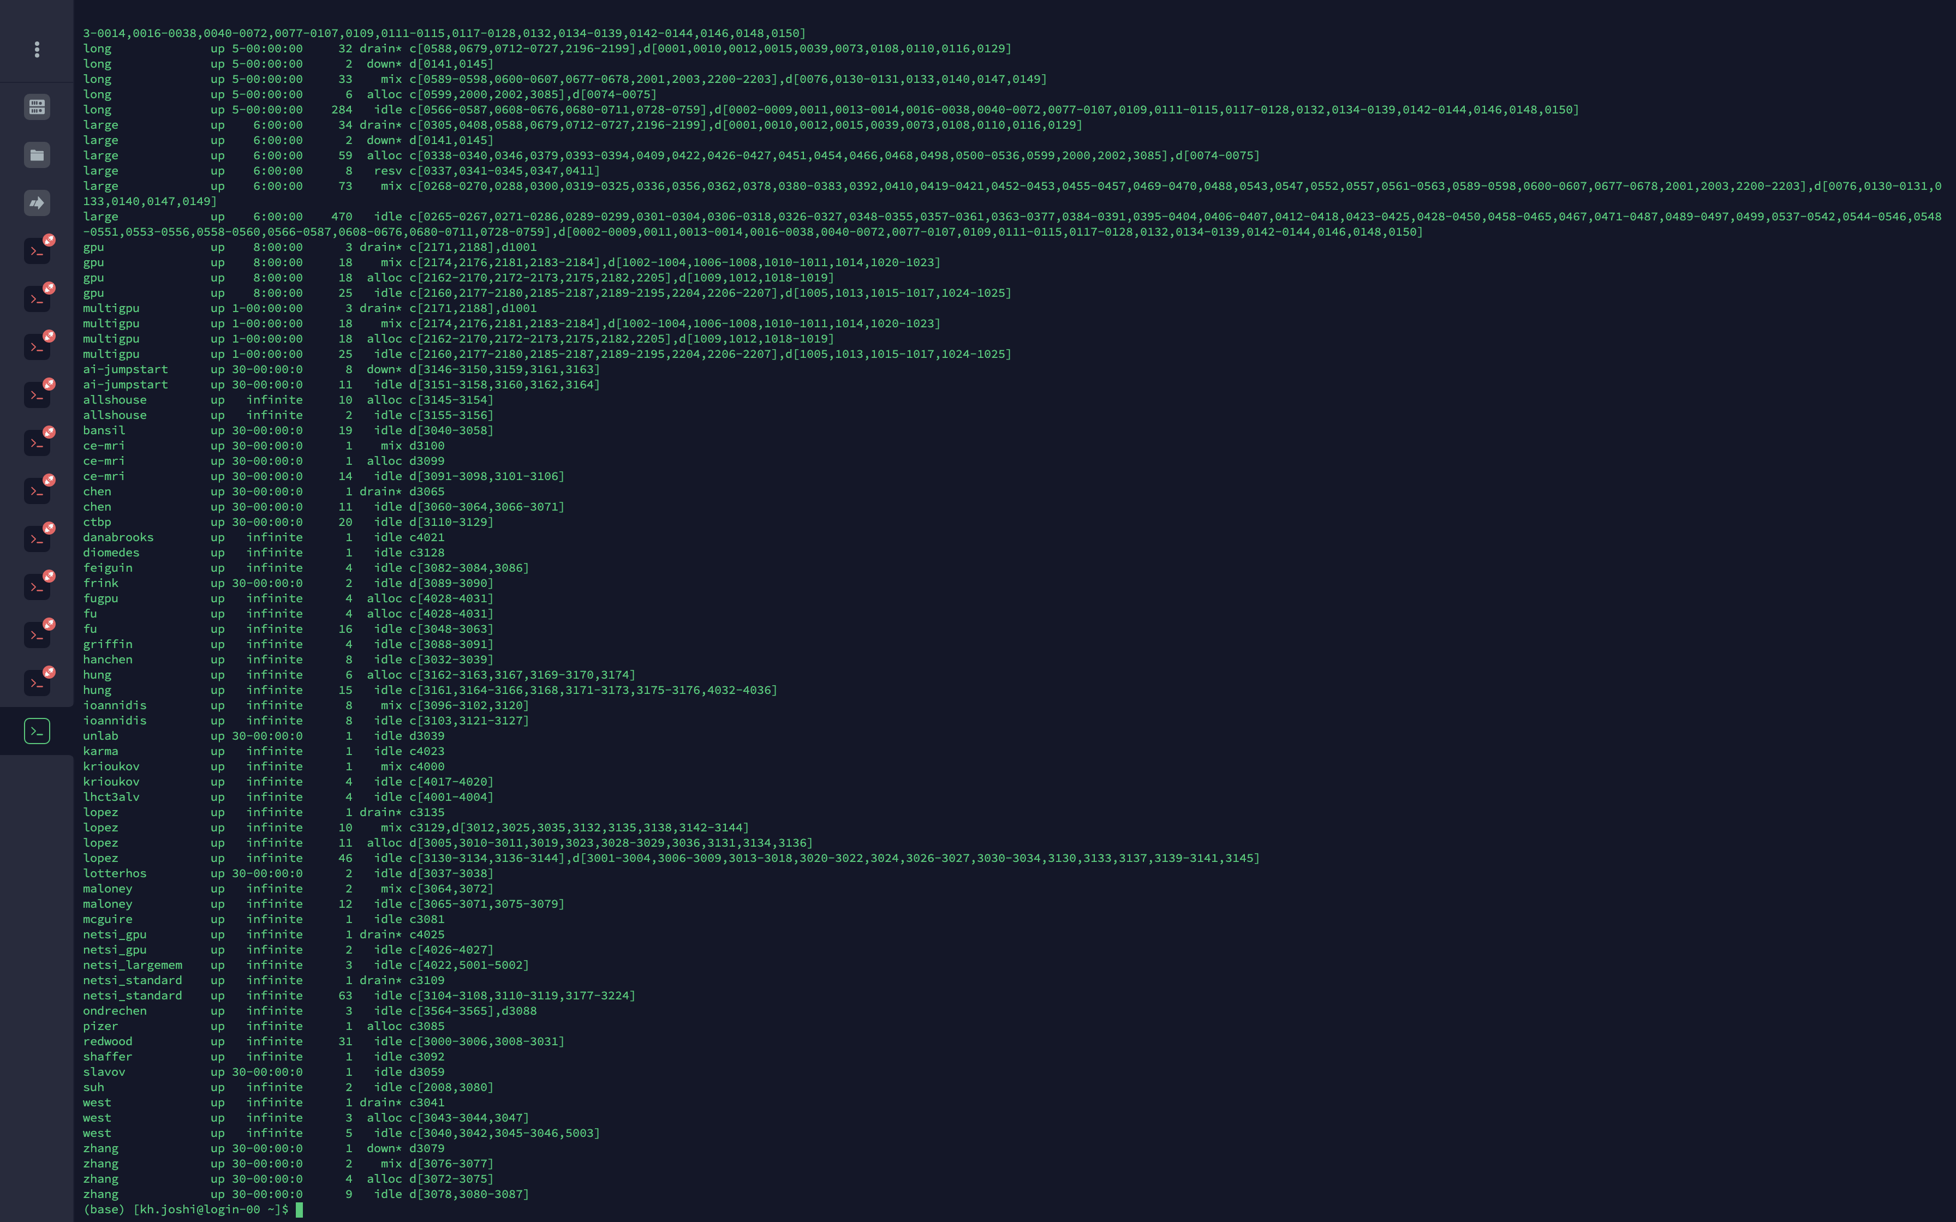
Other Partitions on Discovery
Customized partitions for various groups as per PI’s request
Use the command “sinfo” to see the complete list

Slide 44
DATA TRANSFER ON DISCOVERY
MAC | Using Terminal
 | Using SSHFS
 | Using Globus (recommended for transferring large files)
Windows | Using MobaXterm
 | Using FileZilla
 | Using Globus (recommended for transferring large files)
More details on https://rc-docs.northeastern.edu/en/latest/using-discovery/transferringdata.html

Slide 45
BASIC UNIX COMMANDS

Slide 46
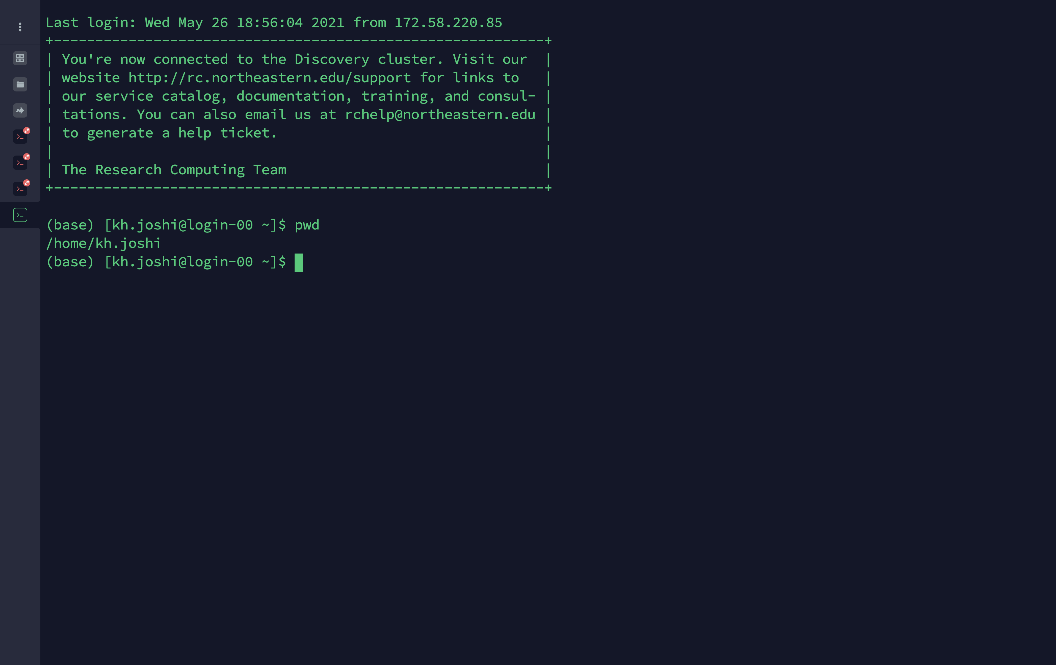
BASIC UNIX COMMANDS
pwd (to print the current working directory)

Slide 47
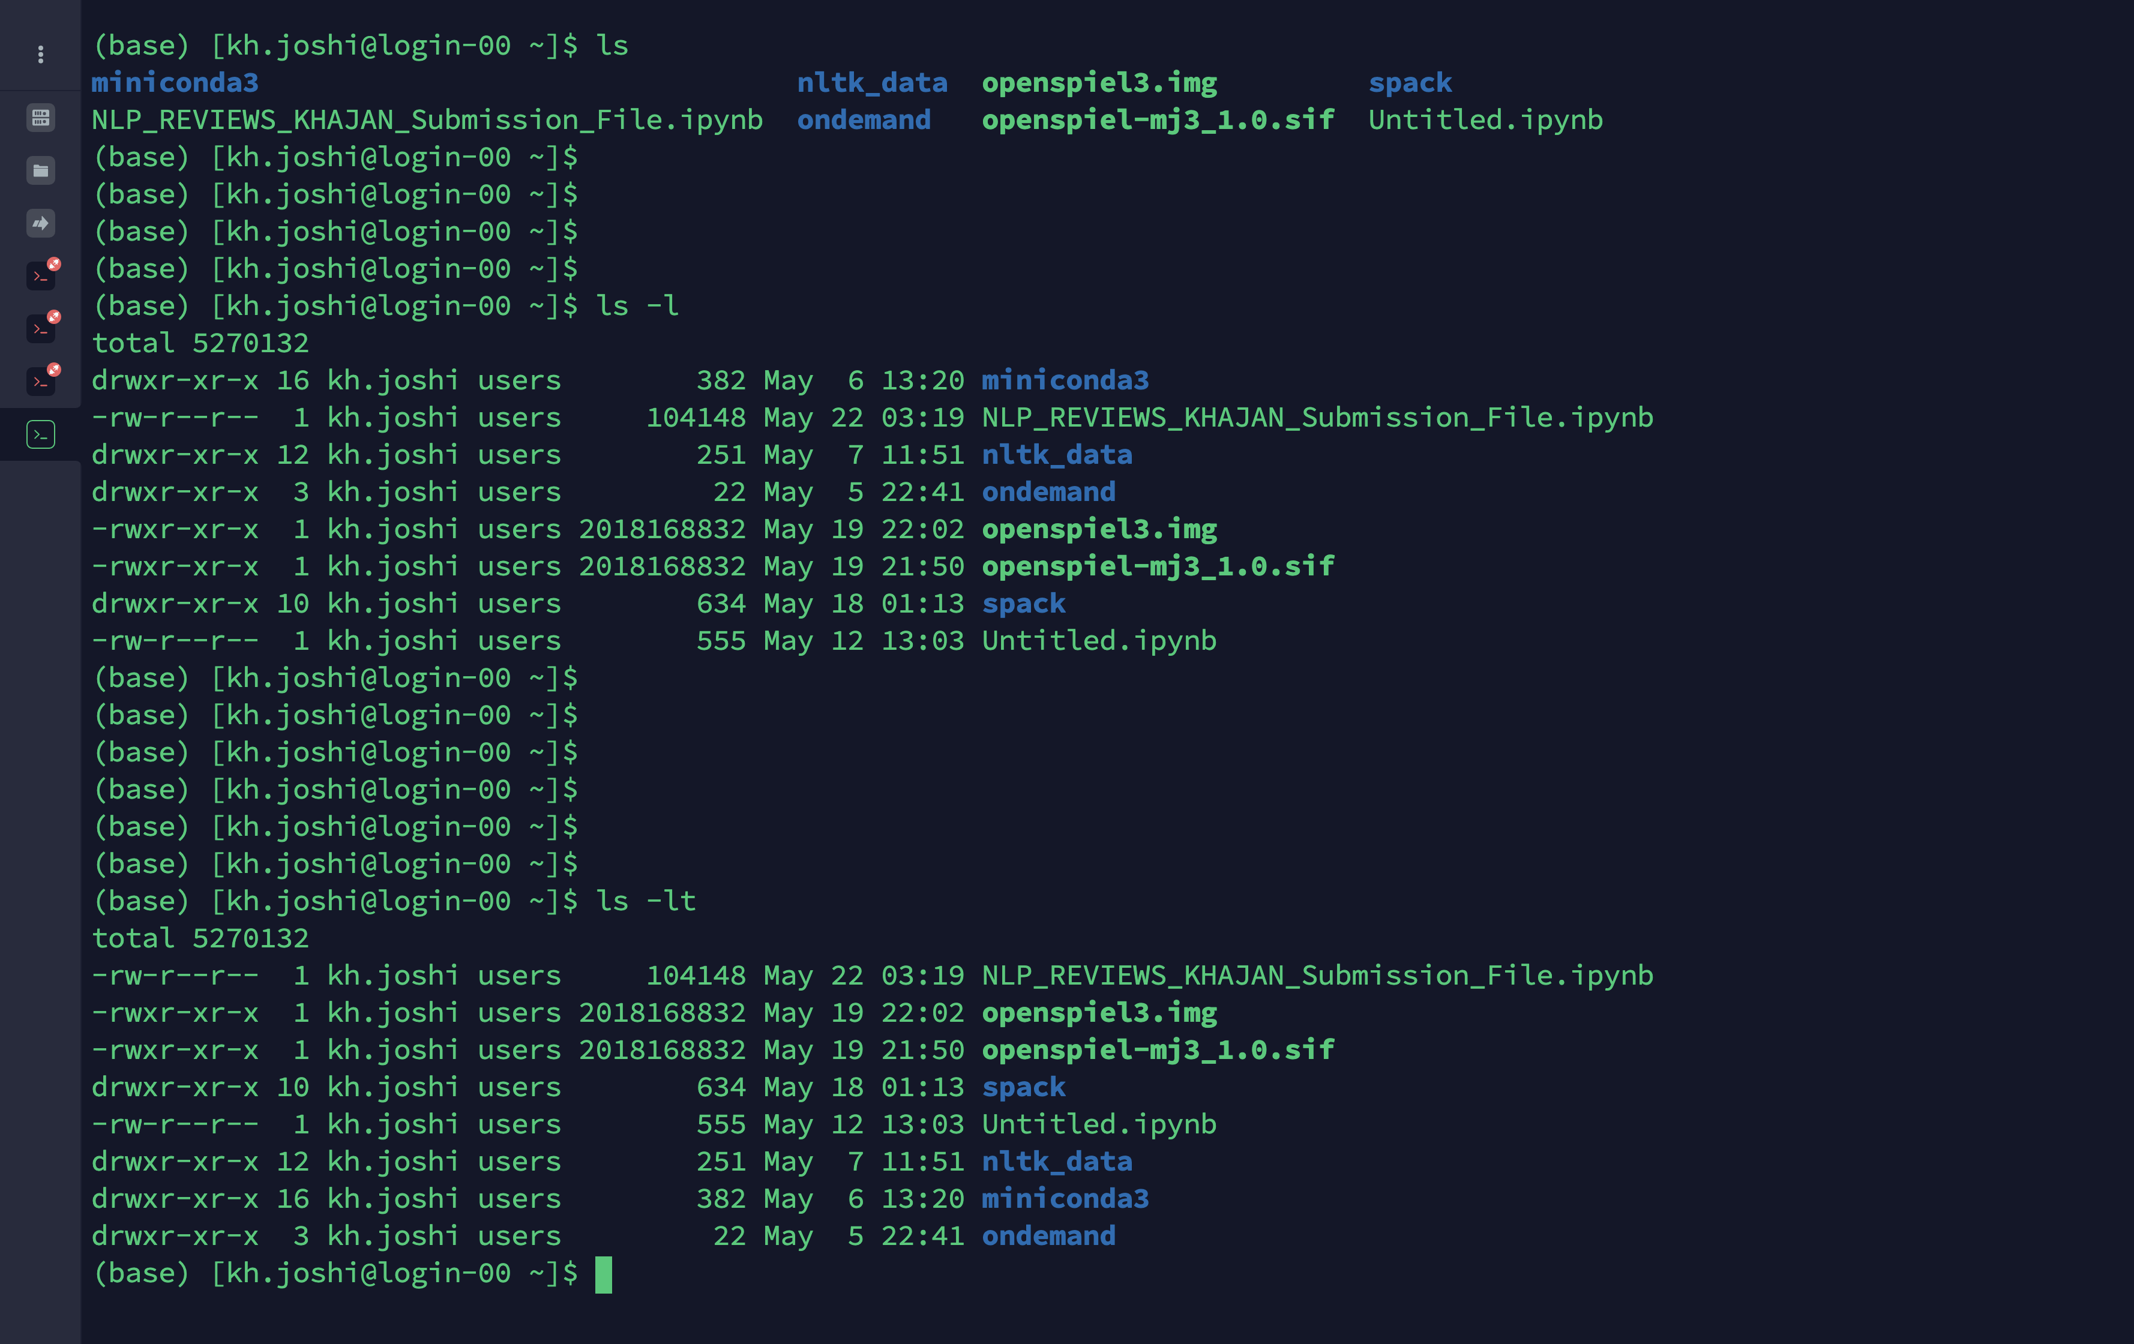
BASIC UNIX COMMANDS
ls (to list files or directories)
Note: ls -ltr (l - as a list, t - ordered by time, r - to reverse the order)

Slide 48
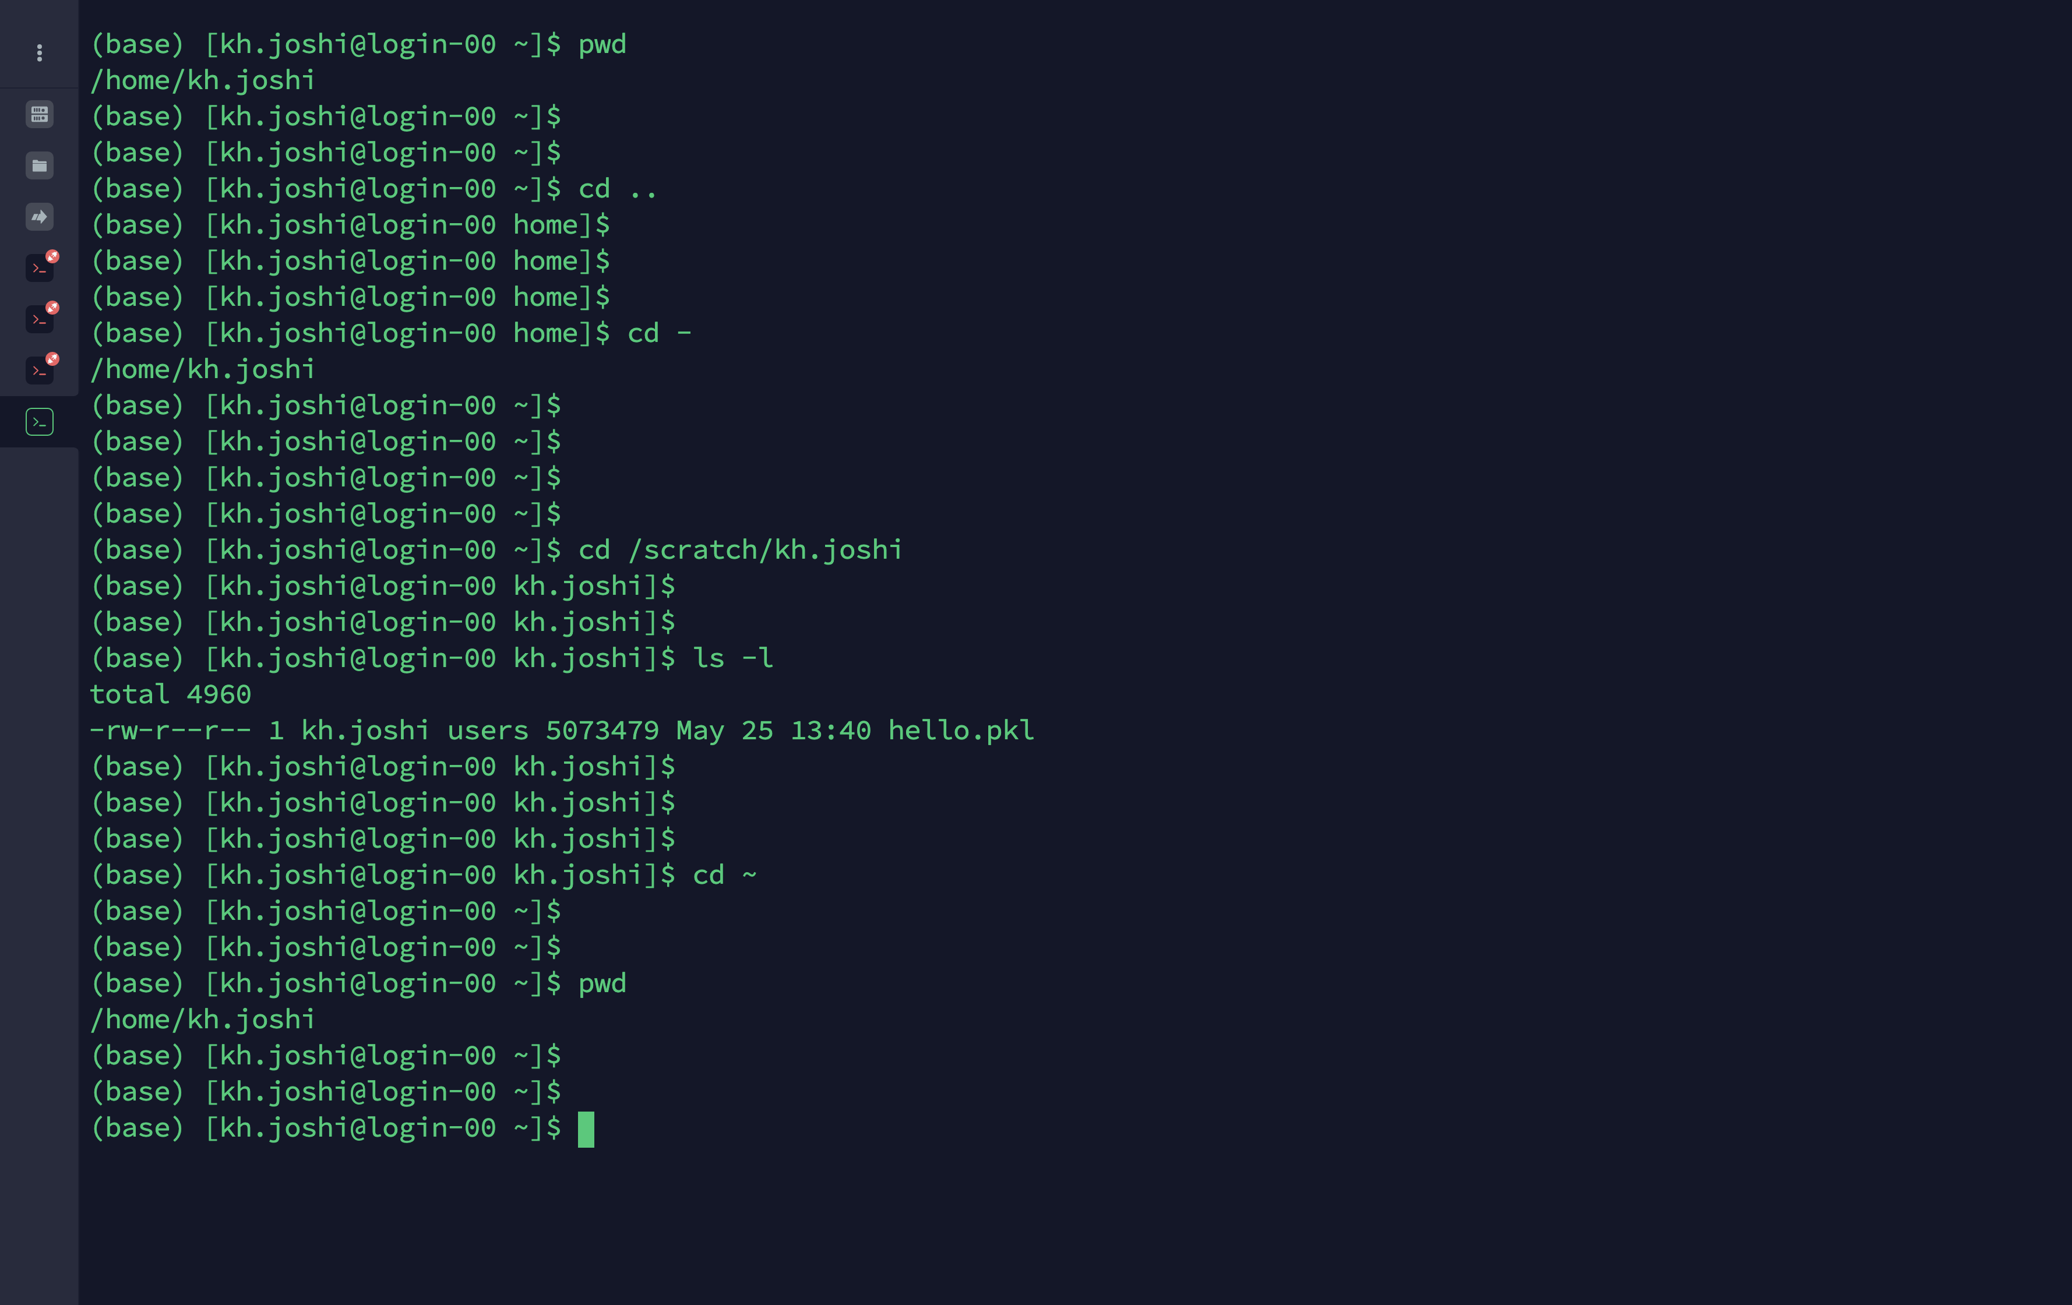
BASIC UNIX COMMANDS
cd (to change directory)
cd .. (cd to one directory up)
cd – (cd back to previous directory)
cd ~ (cd to home directory)

Slide 49
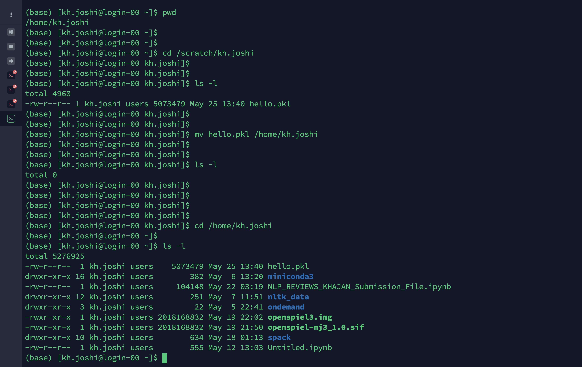
BASIC UNIX COMMANDS
mv (to move a file)

Slide 50
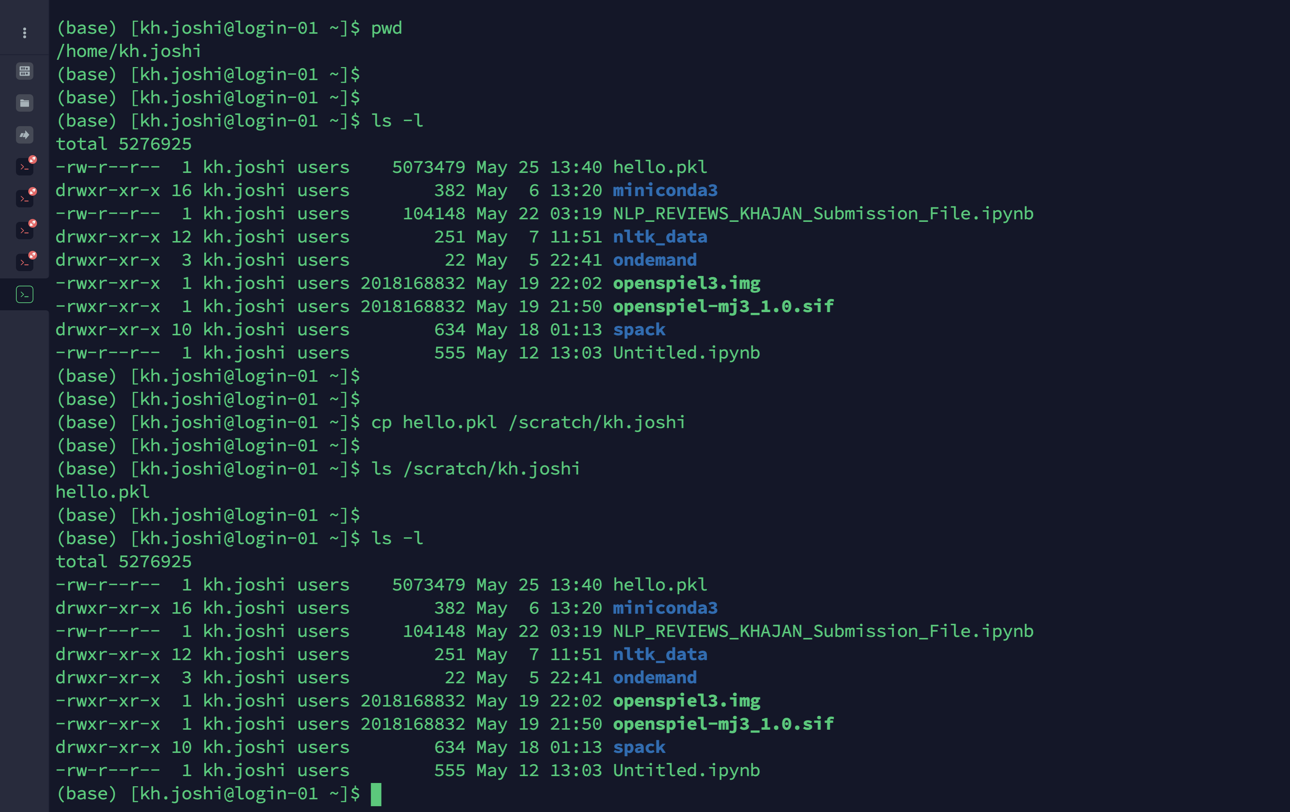
BASIC UNIX COMMANDS
cp (to copy a file)

Slide 51
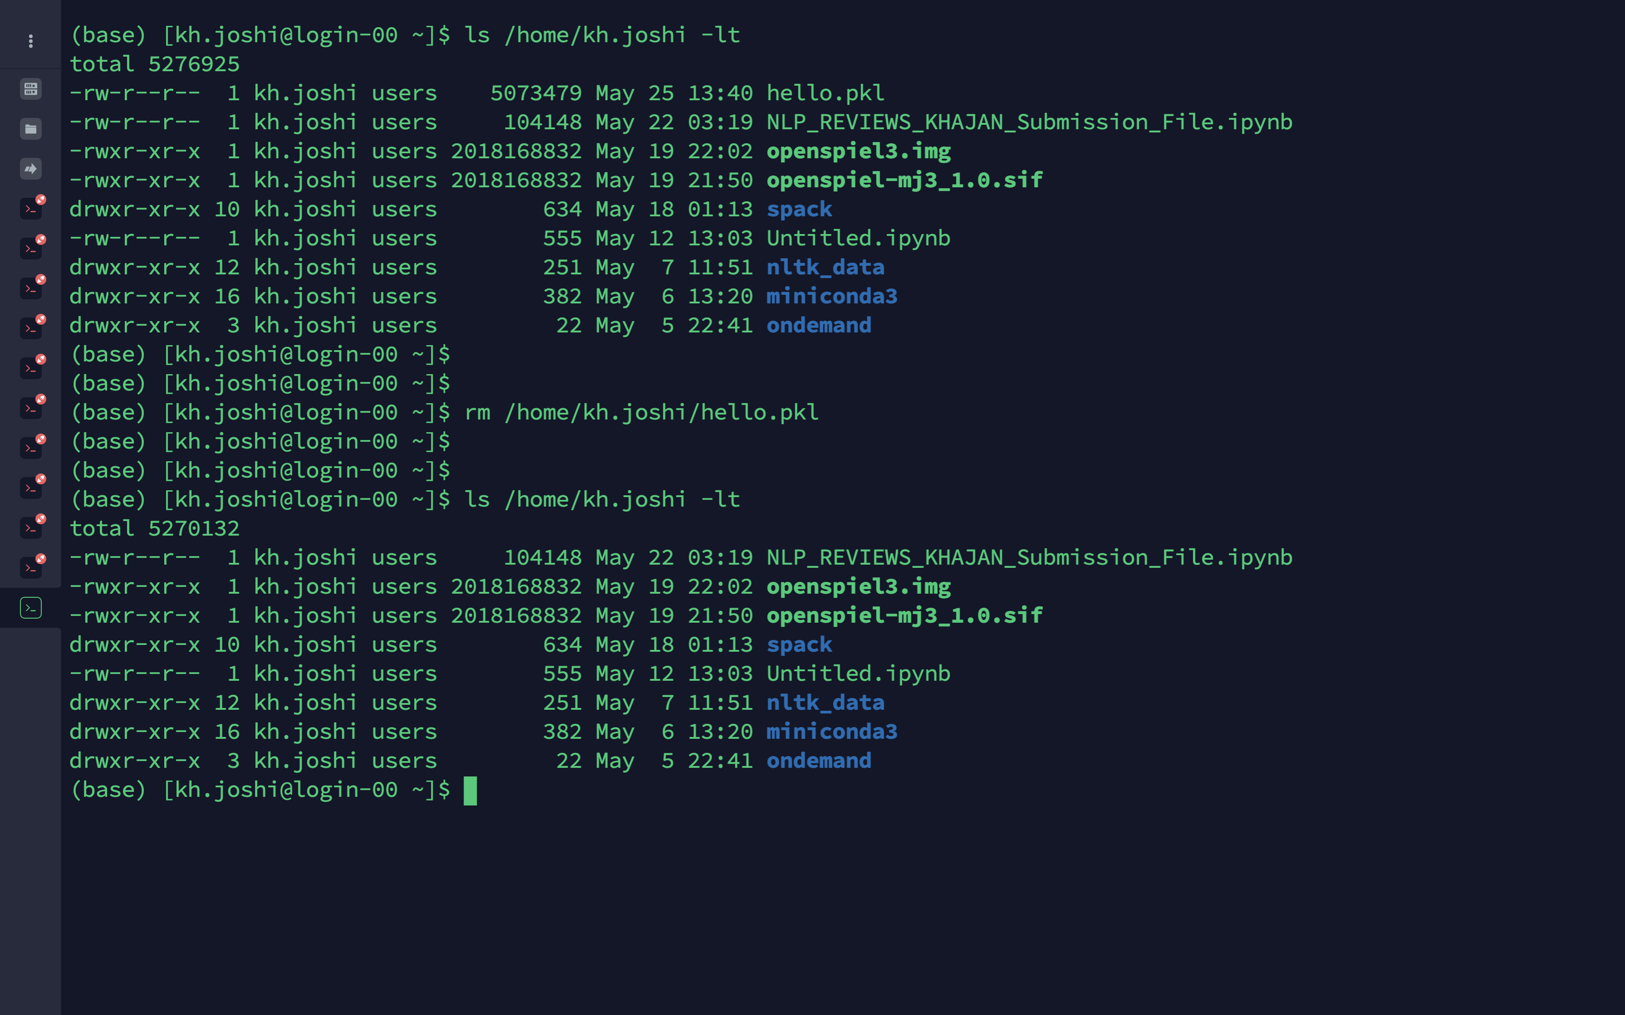
BASIC UNIX COMMANDS
rm (to remove a file)

Slide 52
Exercise 3
Submitting a simple array job

Slide 53
Exercise 3 Array Jobs (Run multiple jobs in the background)
Multiple jobs (sub jobs) can be submitted at once and run in parallel using slurm’s --array directive.
Number of jobs that can run in parallel depends on the limit of simultaneous processes allowed on a cluster.
Even if within the limit, it’s not guaranteed that all sub jobs will get executed simultaneously. Depends on the amount of resources available at the time.
Regardless, all sub jobs will get executed and will still be more efficient compared to submitting and running 1000s of similar jobs on the cluster manually.
Notes:
https://docs.csc.fi/computing/running/array-jobs/
https://scicomp.aalto.fi/triton/tut/array/
https://slurm.schedmd.com/job_array.html

Slide 54
Exercise 3 Array Jobs (Run multiple jobs in the background)
#!/bin/bash
#SBATCH --partition=reservation
#SBATCH –-reservation=Oct2021cpu
#SBATCH --job-name=test
#SBATCH --time=00:05:00
#SBATCH –-nodes=1
#SBATCH –-cpus-per-task=1
#SBATCH --output=%A_%a.output
#SBATCH --error=%A_%a.error
#SBATCH --array=1-4%4
echo "Job array ID: $SLURM_ARRAY_JOB_ID , sub-job $SLURM_ARRAY_TASK_ID is running!"
cd d$SLURM_ARRAY_TASK_ID
cat a.txt
$SLURM_ARRAY_JOB_ID – Job array ID
$SLURM_ARRAY_TASK_ID – Sub-job ID
#SBATCH --array=1-4%4” – Submits the job 4 times with sub-job ID ranging from 1 to 4. Run a 4-job array.
% => how many to run at once
%A – $SLURM_ARRAY_JOB_ID
%a – $SLURM_ARRAY_TASK_ID
Each sub-job enters the directory matching its ID & executes cat command.

Slide 55
Exercise 3 Submit array job using SBATCH
See sample_array_job.bash in Exercise3 folder.
Jobs should be submitted from login node using:
You should see the following output:
When the job finishes, you should have 4 JOBID_SUBJOBID.output & JOBID_SUBJOBID.error files.
If the job completed successfully,
jobid_subjobid.error should be empty, &
jobid_subjobid.output should have the contents of a.txt as output.
$ sbatch sample_array_job.bash
$ Submitted batch job <jobid>

